Slide 1
The Explosion of GIG Economy Workers in Community Banking (The Rise of Fractional Workers)
Roger A. Jones, CPA, CGMA Hauser Jones & Sas, PLLC
Notes:
The Gig Economy is All Around us

Slide 2
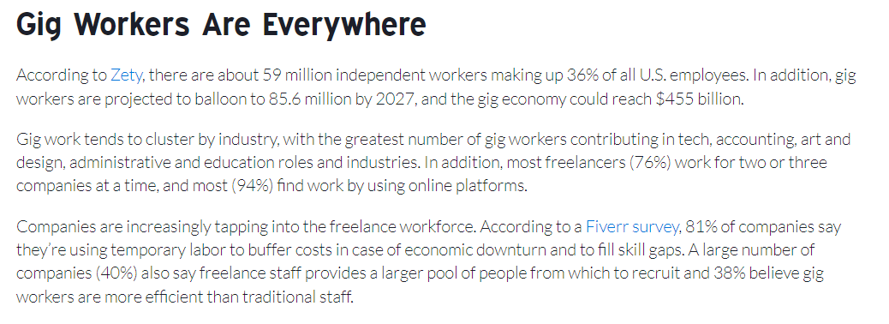
Notes:
59 Million Independent Workers

Slide 3
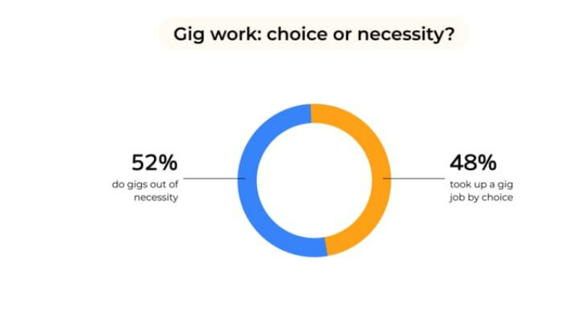
Notes:
Choice or Necessity?
Over 50% say its out of Necessity

Slide 4
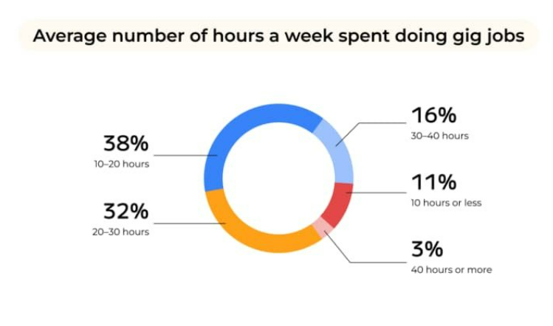
Notes:
Hours Doing Work
Only 16% work 30-40 hours on their gigs

Slide 5
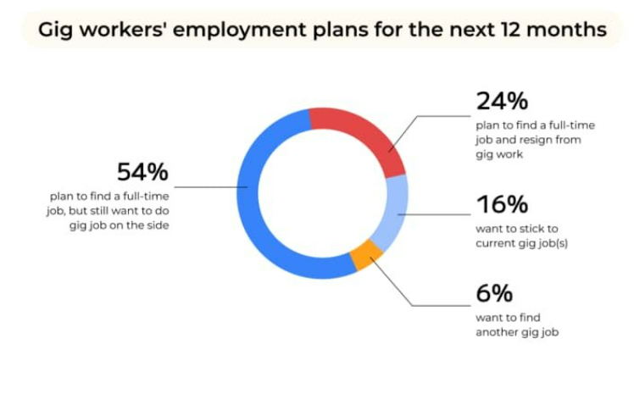
Notes:
Future Plans
Find Full Time Job 54% (but still do gigs on the side)

Slide 6
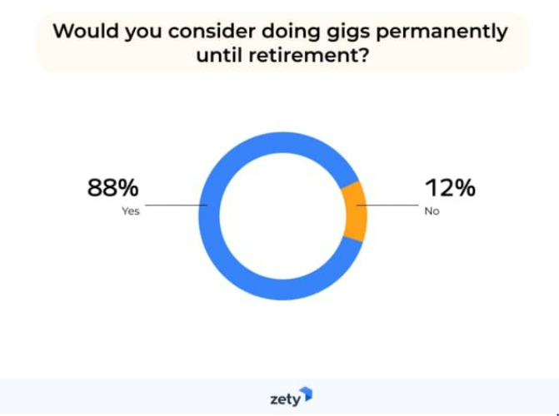
Notes:
Until Retirement
Yes 88%

Slide 7
Notes:
There is a lively debate on the internet about why the word “gig” became a stand-in for “engagement” or “one-time job.”
However, our current sense of the word was popularized by Black jazz musicians in New Orleans during the 1920s as they played different venues throughout the city.
These were the first gig-workers, the creative geniuses
Musicians still describe their paid performances as “gigs,” but the “one-time job” sense of the word has become ubiquitous in our modern times.

Slide 8
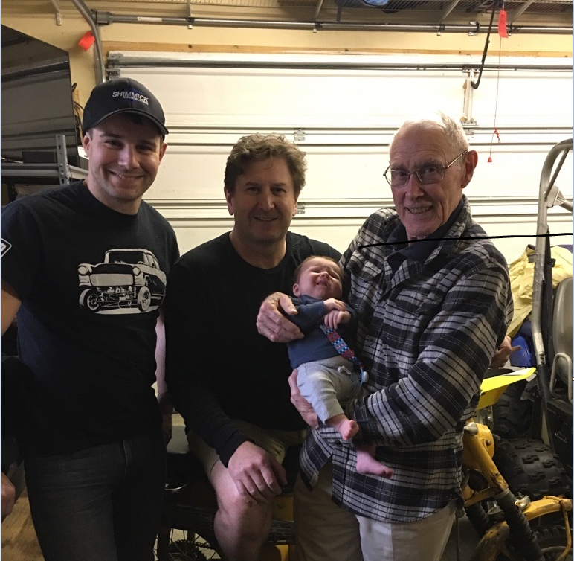
(Great-Grand) Father of the Gig Economy?
Notes:
My Father Claims to be an early founder of the GIG economy:
Whenever we get together for family gatherings my 83-year-old dad likes to brag.
Grandkids, Retirement, his “Work Ethic” “back in the early 50’s”
He Brags about leading edge of the GIG Economy Work Force Trend,”
He points out his many part-time occupations as a pre-teen and teenager –
his jobs at the time were all basically the same format as today’s gigs:
He Argues that
*Temporary
*Contractor
*Part-time hours

Slide 9
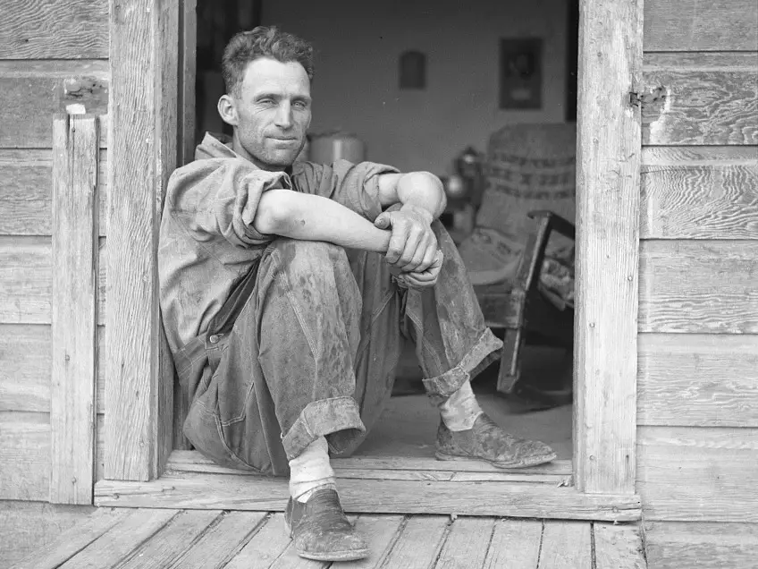
My Father’s Generation of the Gig Worker
His jobs were part-time or temporary in duration,
They were often with multiple different employers at the same time,
None of the positions were permanent or guaranteed,
All basically paid a fixed or guaranteed piecework for the project’s performed.
He sometimes shared the work with others (Principally my Grandfather).
Notes:
I always remind him that it was the great depression then – and just about everyone was doing any kind of work they just to get by…
So you didn’t invent the Gig Economy, you just couldn’t hold a job!!!
Of course this was after the great depression. Born in 1939, by 1950 my dad was working and it
Hard to get a job (well after the New Deal).

Slide 10
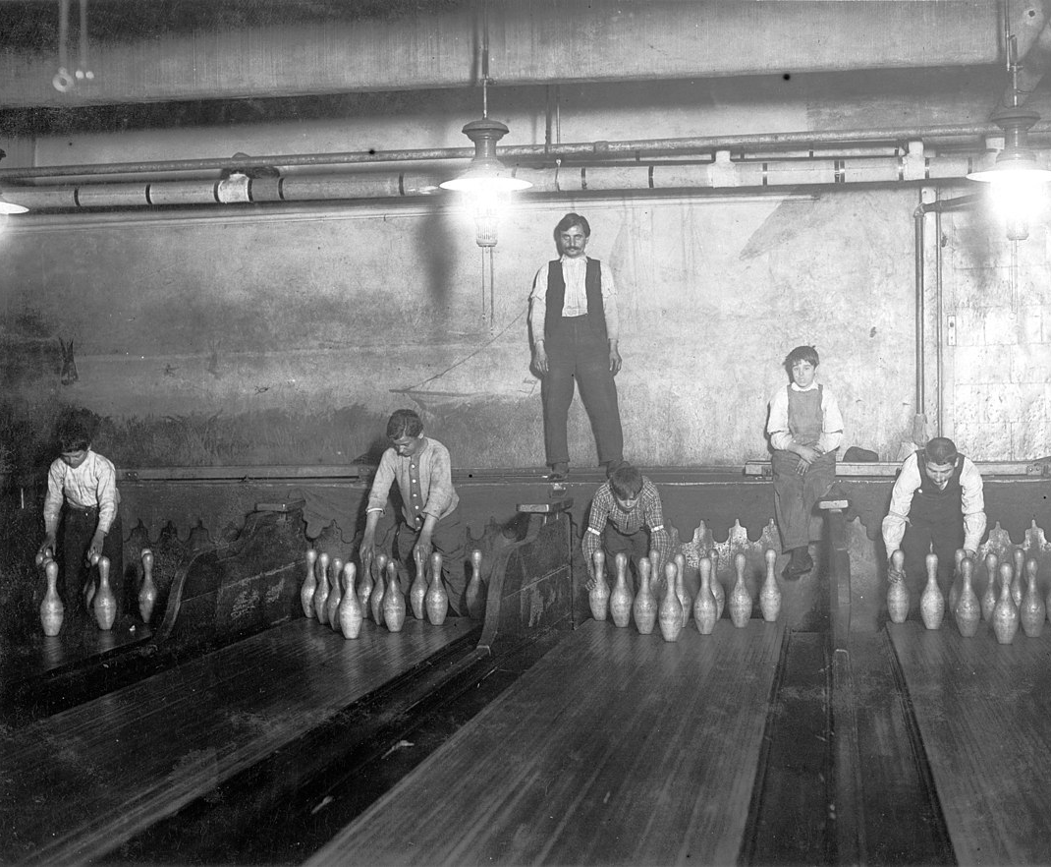
Notes:
My dad always recalls with a smile that his favorite gig was pin setting at the local bowling alley in Los Angeles where he lived as a pre-teen –
I think he said he made 25 cents/hour and he felt rich.

Slide 11
Notes:
I was always interested in his logging stories.
Depending on the day of the week or time of year the “Jones family “gig’s”” might encompass
logging up in Sumas WA,
mowing lawns around town,
acting as the church janitor,
and for several years traveling from CA to WA as migrant farm workers.

Slide 12
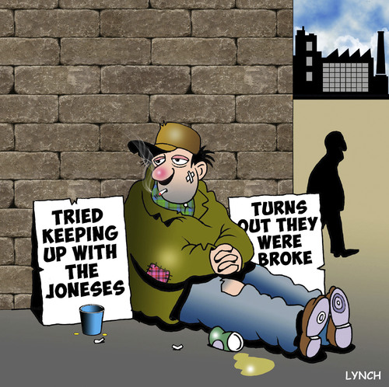
Keeping Up with the Joneses
Notes:
The Jones family gigs weren’t all they were cracked up to be at the time…

Slide 13
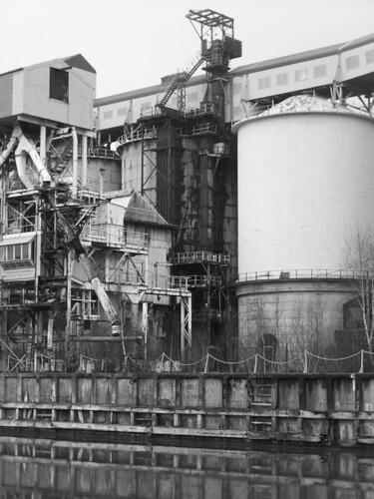
Union Jobs - Good Retirement
Notes:
My dad moved around a lot in his careers even as an adult in the 60’s 70’s etc..
But My dad’s peers had “good steady jobs,”
and they had spent 30-40 years working at the same place –
such as the Georgia Pacific pulp mill or
operating machinery at the local ARCO Oil refinery out in Ferndale, or
serving in various local government positions.

Slide 14
Workers Did Not Move Around Much
Notes:
Of course, in exchange for that employer loyalty when they retired, this generation of worker all received guaranteed pensions
So workers did not move around much.

Slide 15
2016 Study
1. Changes in the American workplace
A shifting economic landscape is driving significant changes in the American workplace.
Employment opportunities increasingly lie in jobs requiring higher-level social or analytical skills, or both.
Physical or manual skills, as much in demand as social or analytical skills some three decades ago, are fading in importance.
Not coincidentally, employment is rising faster in jobs calling for greater preparation, whether through education, experience or other forms of training.
A key factor is the decline in manufacturing employment, by about a third just since 1990.
Meanwhile, employment in knowledge-intensive and service-oriented sectors, such as education, health, and professional and business services, has about doubled.
Underlying factors such as globalization, outsourcing of jobs and technological change are among the key forces contributing to the transformation.
according to an Economic News Release from the U.S. Bureau of Labor Statistics.﻿ However, this longevity varies by age and occupation:
Notes:
The Econcomy has changed in the past several Decades.
With Technology Changes Came Need for New Job Skills
2016 PEW Research Center performed a comprehensive assessment of changes in the workplace.
Higher level social and analytical skills needed.
Physical skills in less demand.
More education needed for today’s jobs
Decline in manufacturing by 1/3 since 1990
Knowledge workers on the RISE
Globalization/outsourcing/technology are driving forces for change

Slide 16
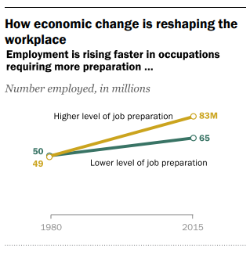
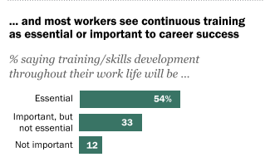
Notes:
1980 to 2015 In Millions:
49 million up to 83 million jobs require advanced training.
Continuous training is important for 87% of worforce

Slide 17
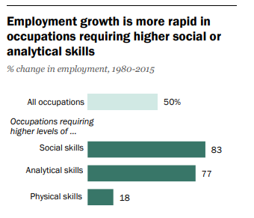
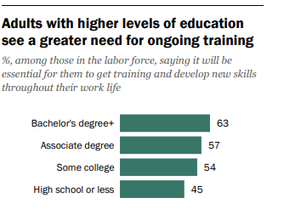
Notes:
83% increase in jobs require social skills
77% require good analytical skills
Only 18% physical.

Slide 18
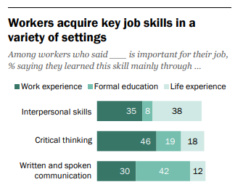
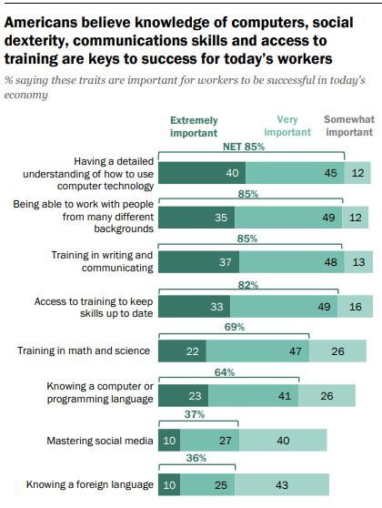
Notes:
“Work” not necessary to gain social skills or communication skills
Knowledge of computers, social skills and communication are very important for 88% of workers.

Slide 19
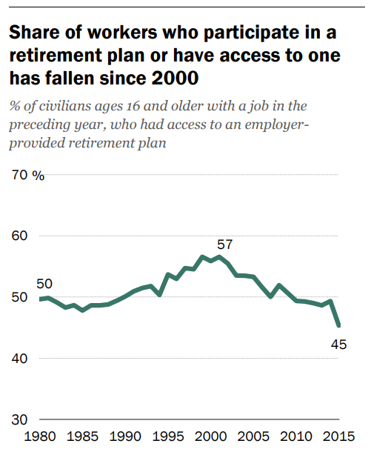
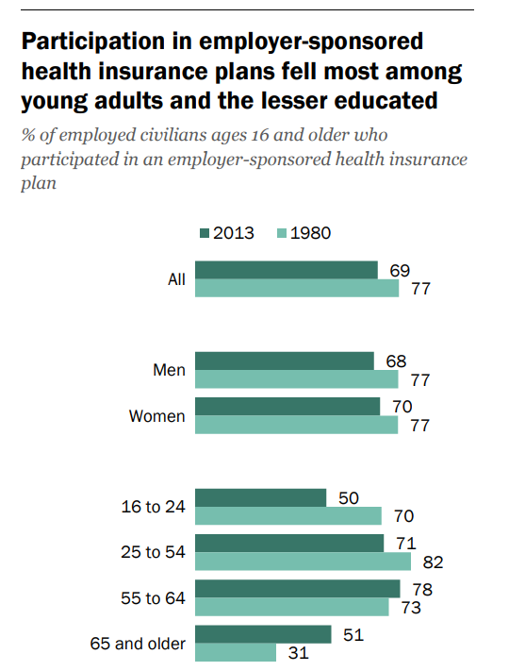
Notes:
Employer Benefits are Seen Decreasing…
Fewer benefit plan participants
Fewer participating in medical plans.

Slide 20
Benefit Pension Plan Models
Notes:
Benefit Plans Changed…(got worse) so the long-term incentive was reduced.
No more DB Plans…

Slide 21
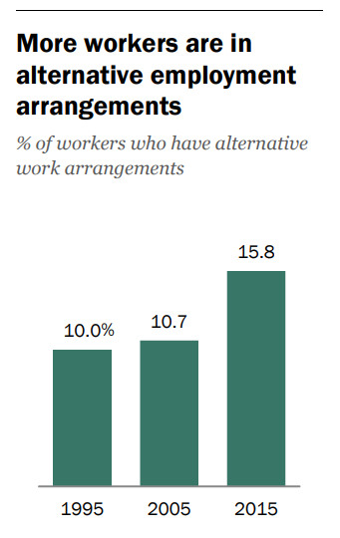
“Alternative employment arrangements” refers to the hiring of workers who are independent contractors or sourced through contract firms, on-call workers, or temporary-help agency workers.
About 24 million workers currently work in these arrangements in 2015
Notes:
Surge in “Alternative” employment arrangements…
This is all Pre Pandemic – These trends were starting in 2015 and prior decades.

Slide 22
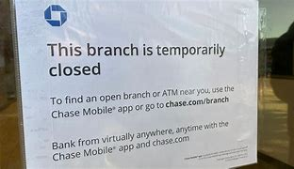
Notes:
Then Covid Hits Us All
Everyone Went Home –
Except….Knowledge workers stayed connected and plugged in…

Slide 23
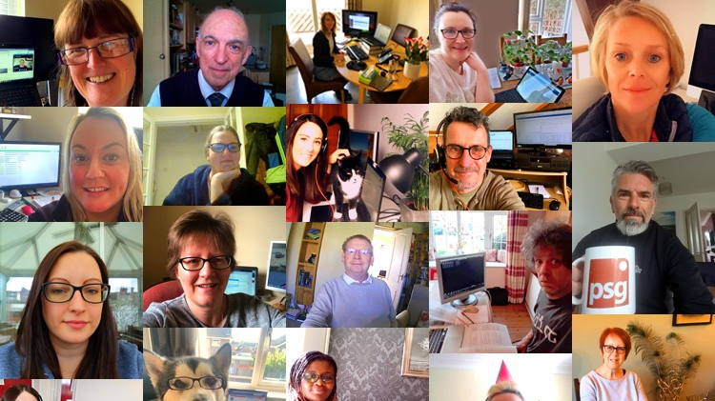
Covid Hit and We all Started Working Remotely
Notes:
Lots of these meetings

Slide 24
Notes:
Lots Of these were purchased….
And are gathering dust today…

Slide 25
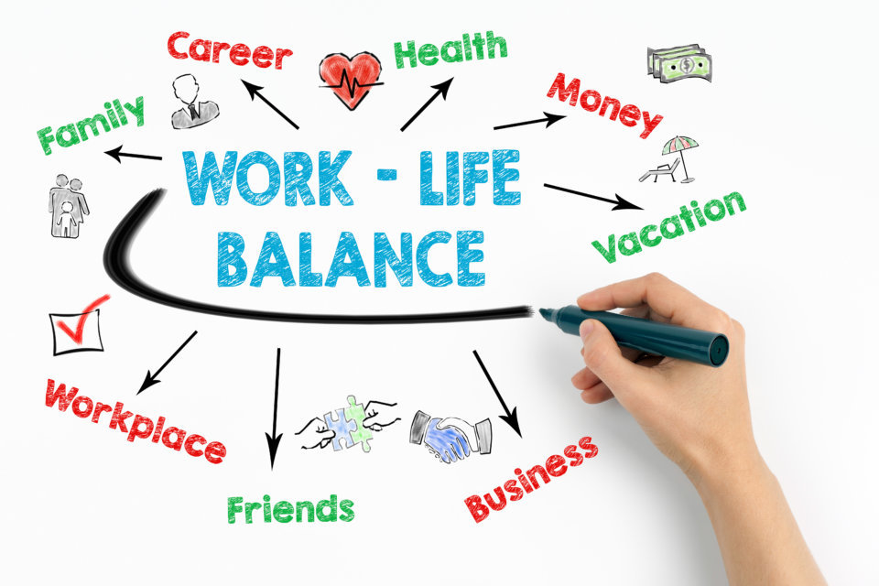
Notes:
It was like perfect storm causing workers to consider their work-life balance…

Slide 26
Notes:
We started talking about mental wellness in public….

Slide 27
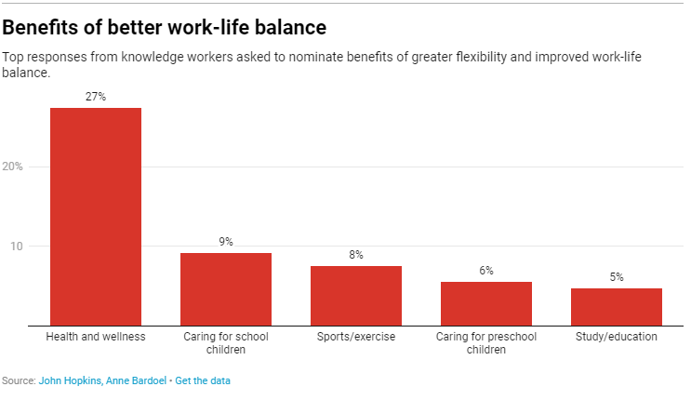
Notes:
And measuring our satisfaction levels..

Slide 28
Notes:
The Pandemic accelerated and exacerbated this dilemma…
Millions of People resigned from the work force…

Slide 29
Words I leaned From the Covid Pandemic
“The Great Resignation”
“Phased Retirement”
“Hybrid Work”
“Quiet Quitting”
“Moonlighting”
“Virtual Meetings”
“Robot Workers”
“Self-Checkout”
Notes:
As An Employer I’ve been losing sleep over these words….
The Great Resignation
Phased Retirement
Hybrid Work
Quiet Quitting
Moonlighting
Virtual Meetings
Robot Workers
Self-Checkout
Self-checkout is more a personal issue…

Slide 30
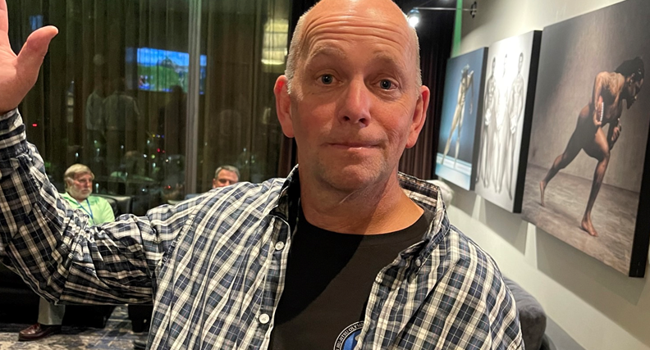
Notes:
Moonlighting as a Tax Accountant

Slide 31
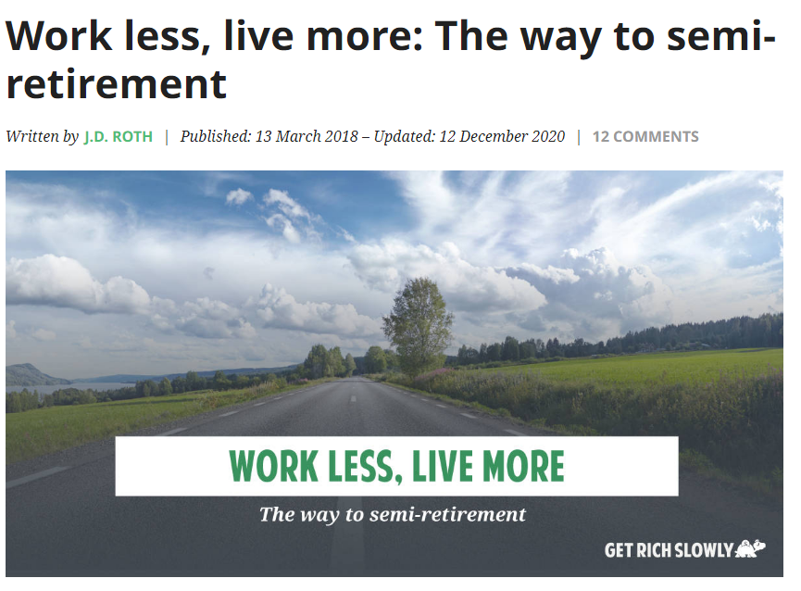
Phased retirement Is a Real Thing…
Retaining highly skilled knowledgeable workers
Training and mentoring of younger, newer employees
Easier forecasting of future workforce needs
Greater flexibility
Boomers have less $$ than they thought
Notes:
My Dad touts his trendsetting with “Phased Retirements” !!
He slow=retired from AON insurance then Returned to Programming Part Time.
Then he quit programming and went back to Teaching 2-3 classes a week at local college
(He Got fired for failing students in Geometry 101)
Now he just mows lawns again…
FULL CIRCLE!

Slide 32
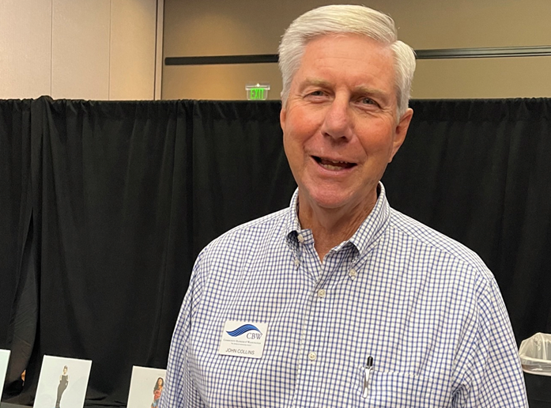
Notes:
2000 started

Slide 33
Technology advances permit remote work anywhere
Notes:
My Dad is Not Alone:
My Close Friend “reimagined” his work life after quitting a high-paying Amazon position. Now Consulting.
My Engineer Client is a W-2 Employee (for the insurance because his wife is self-employed) but makes more on side gigs programming.
This Morning I spoke to a former CFO client (“Retired”) who is working at a friends Institution to shore up their accounting functions.

Slide 34
Gartner Research Group 2021
Notes:
Study by Gartner Research Just Last Year on Impact of Covid on Workers

Slide 35
1) Hybrid Work Becomes Mainstream
2) There is a shortage of critical talent
3) Well-being is a metric
4) DEI outcomes could worsen
5) Turnover will increase
75% of remote knowledge workers agree their expectations for working flexibility have increased.
Mental and emotional well-being programs are the most common additions.
On-site employees are more likely to be promoted
52% of employees say flexible work policies will affect their employment decisions.
Notes:
Hybrid Work is Mainstream
Shortage of Critical Talent
Well-being is a metric
DEI Outcomes could worsen
Turnover will increase

Slide 36
6) Manager’s Roles are Changing
7) Gen Z wants in-person work experiences
8) Shorter work weeks are a new benefit
9) Data collection is expanding
Managers need to be more intentional about establishing interactions.
To Gen Z, remote work is about continuing connections build in person.
Pressure on compensation levels are forcing employers to consider reduced working hours requirements.
16% of employers are more frequently using technology to monitor their employees.
Notes:
Manager’s Roles are Changing
Gen Z wants in-person work
Shorter work wees are new benefit..
Data collection is expanding to monitor employees

Slide 37
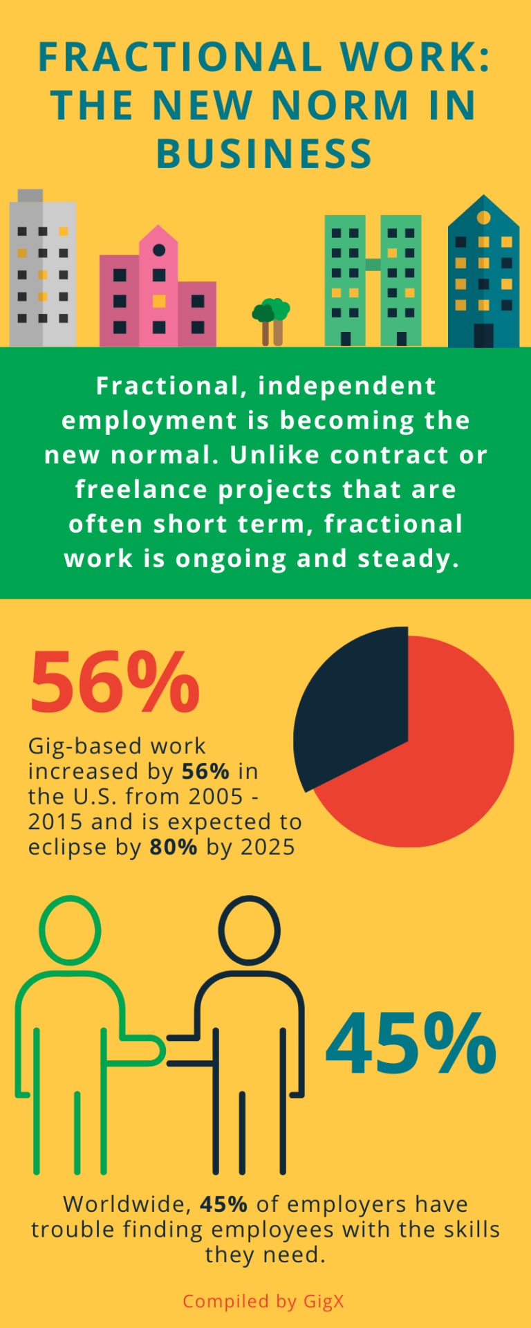
Businesses are hiring but struggling to source talent, and freelancers help solve that talent shortage.
Independent talent provides access to specialized skills that the business may not have on staff.
Organizations that work with independent talent are more confident about withstanding turmoil.
Worker's ability to deliver regardless of distance and location has accelerated since the Pandemic.
According to Bloomberg.com, more than 75% of US businesses prefer to hire freelancers/fractional workers in an uncertain economy. That’s a huge number and points to a major shift for employers and employees alike.
Notes:
Independent Fractional work is Ongoing and Steady
GIG Based Work is up 56% from 2005 to 2015.
Expected to increase 80% by 2025
45% of Employers cannot get enough labor.

Slide 38
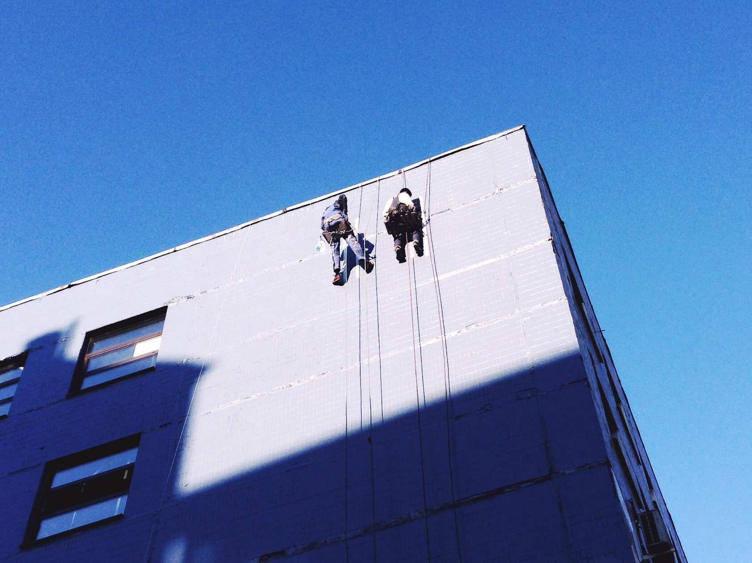
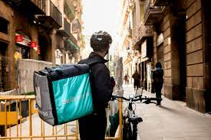
The Fractional Workforce is on the Rise across all industries and the Accounting industry is a good example of how that is transpiring.
Notes:
Fractional Independent Employment is Ongoing and Steady –
Not really freelance or piecework –almost like a part-time position – but under contract.

Slide 39
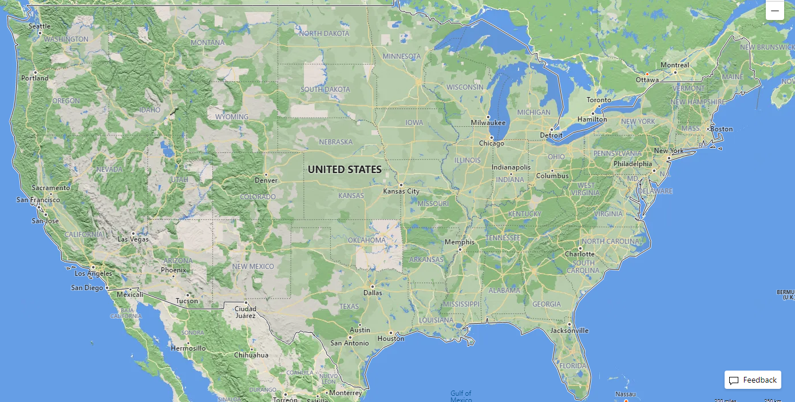
Hawaii
HJ&S Fractional Work Experience
Notes:
Independent Fractional Work is Ongoing and Steady
HJ&S is Yellow Star:
Gold stars represent our remote employees at present. (7 are more than 100 miles away)
(Map is too small to show truly who is remote vs. in office)
Black Stars represent our fractional independent employees at present
All are remote:
Blue stars represent examples of clients where we supply fractional employees
(CFO, Internal Audit, Payroll Processing, Bill Payment, Financial Statements)

Slide 40
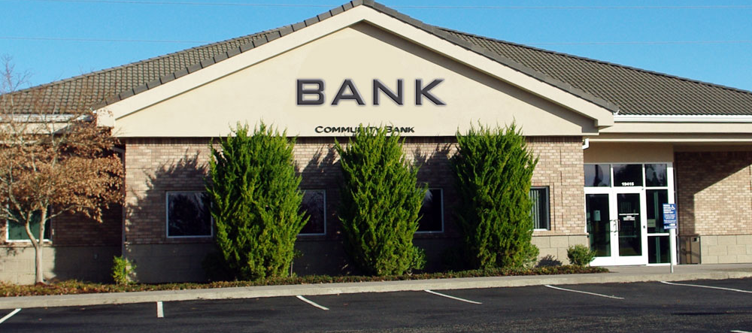
Banking is well suited for fractional workers

Slide 41
Banking is Well Suited for Fractional/Hybrid Workers
Epitome of Knowledge Work
Explosion of software applications
Primarily Digital Assets
Brick and mortar benefits are declining
Automated processing and reporting
Physical Presence seldom needed (actively discouraged by some)
Notes:
No Physical Skill Required
Heavy reliance on automation
Digital records
Remote works
Physical presence is seldom needed
Automated processing and reporting
Epitome of knowledge work
Decisions become automated
One Client Shut Down their HQ and Sold Building…

Slide 42
Where We See Fractional Workers
Loss of key employee
Phased Retirements
Sabbatical Programs
Overhead cutback – efficiency
Remote HQ’s
Independence is Needed
Handling Excess Volume
Technical Expertise
Notes:
We need fractional workers for:
Workload reductions
Technical expertise
Loss of Key Employees

Slide 43
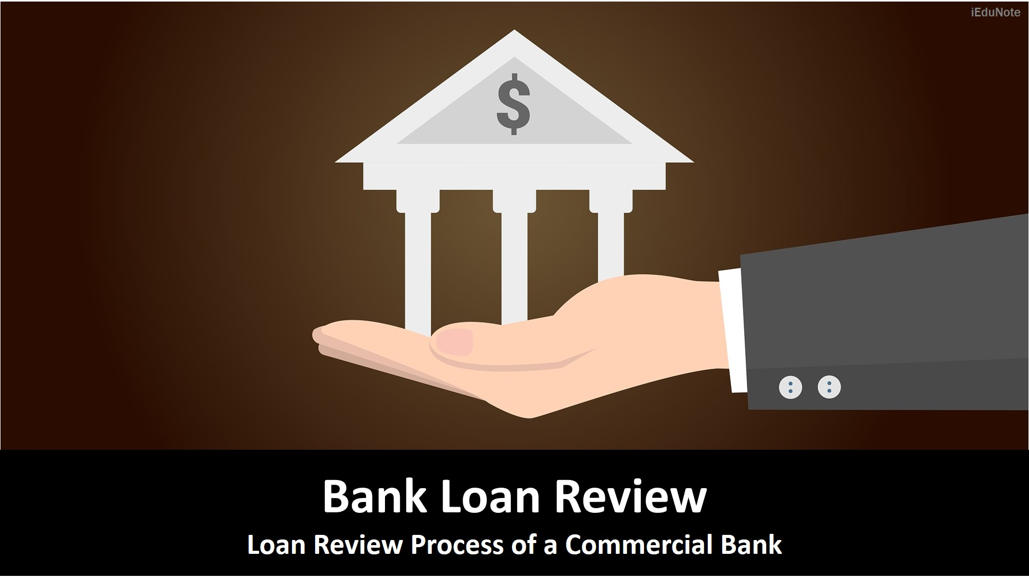
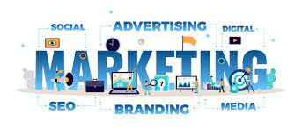
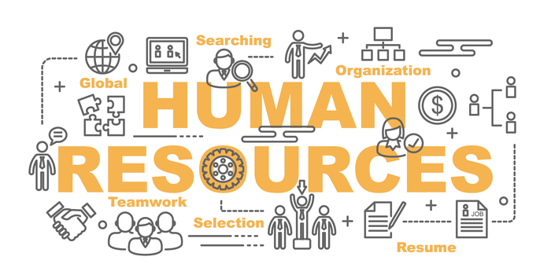
Knowledge areas suited for fractional employees
Notes:
Loan Review
Compliance Audits
Internal Audit
Customer Service
Financial Reporting
Mortgage loan QC
Stock certificate tracking
ALM reporting
ATM Management/cash handling
Loan Underwriting
Know Your Customer Documentation
Janitorial Services
[Loan Brokers]

Slide 44
Back Office/Finance
Payroll processing
Bookkeeping and accounting, month-end closing procedures
Call report preparation
Budgeting and Forecasting
Portfolio management
Notes:
Payroll processing
Fixed Asset Accounting
Annual Loan Review Updates
Budgeting and Forecasting
Portfolio Management
Call Report Preparation

Slide 45
What Fractional Services Should YOU be Providing?
Notes:
This Is Something we Think about a lot…
What Should YOU Be doing for your customers?

Slide 46
The Explosion of GIG Economy Workers in Community Banking (The Rise of Fractional Workers)
Roger A. Jones, CPA, CGMA Hauser Jones & Sas, PLLC
Notes:
The Gig Economy is All Around us

