Slide 1


Community Bankers of Washington
September 16, 2022
Navigating a Volatile Environment: Trends & Strategies for Community Banks

Slide 2
1
1. Balance Sheet & Earnings Trends
National Peers & Washington Banks

Slide 3
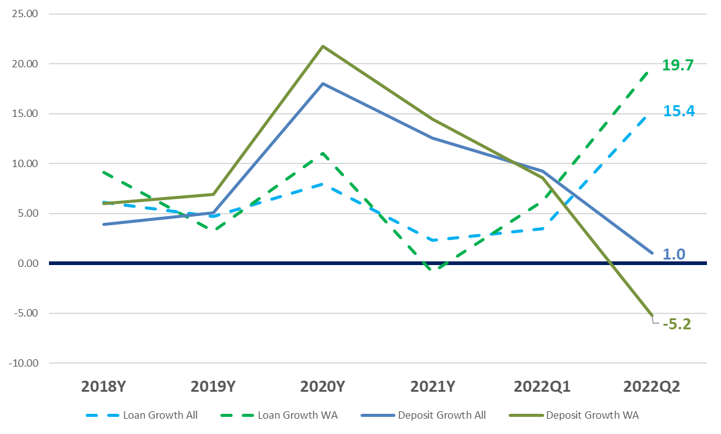
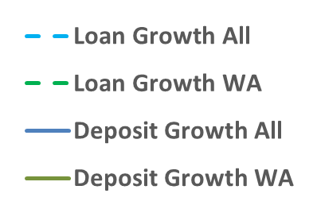
Balance Sheet Composition Trends: Reaching an Inflection Point
To examine peer positioning, the chart below summarizes loan and deposit growth in recent years/quarters
  2022Q2 saw significant loan growth coupled with deposit outflows, reversing a trend not seen since 2018Y
Loan & Deposit Growth
Source: S&P Global, all banks $100M to $50Bn Total Assets as of 2022Q2

Slide 4
Balance Sheet Composition Trends: Reaching an Inflection Point
Loan growth and deposit outflows resulted in an increase in the Loan/Deposit Ratio
Deposit outflows were visible in the significant drop in cash balances quarter over quarter
Loans/Deposits
Cash/Assets
Source: S&P Global, all banks $100M to $50Bn Total Assets as of 2022Q2, Medians

Slide 5
Balance Sheet Composition Trends: Reaching an Inflection Point
Securities/Assets saw massive increases but have leveled off in recent quarters as loan growth picked up
Recent deposit outflows have resulted in a slight uptick in borrowings
Securities/Assets
Borrowings/Liabilities
?????
Source: S&P Global, all banks $100M to $50Bn Total Assets as of 2022Q2, Medians

Slide 6
Margin Trends: Reaching an Inflection Point
Net Interest Margins finally reversed due to increased loan growth and rising interest rates
Cost of Funds have remained low as of 6/30/2022, but have seen signs of pressure in 2022Q3
Net Interest Margin
Cost of Funds
?????
Source: S&P Global, all banks $100M to $50Bn Total Assets as of 2022Q2, Medians

Slide 7
Margin Trends: Reaching an Inflection Point
Yield on securities increased as a result of rising interest rates and spread widening in certain sectors
Yield on loans increased slightly in second quarter and likely will continue into the second half of 2022
Yield on Securities
Yield on Loans
Source: S&P Global, all banks $100M to $50Bn Total Assets as of 2022Q2, Medians

Slide 8
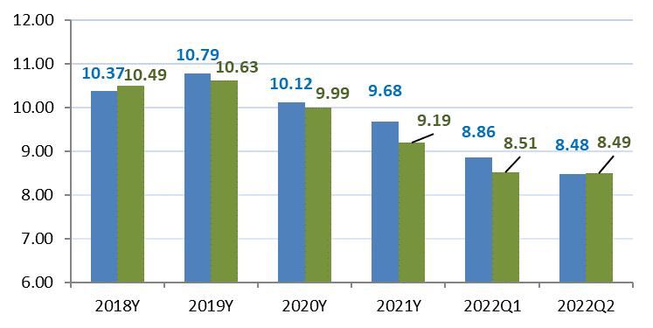
Capital Trends: Reaching an Inflection Point
With improved earnings and rotation out of cash into loans, leverage ratios have increased while risk based capital is being used more efficiently
TCE/TA remains under pressure as unrealized losses in AFS portfolios flow through AOCI
Tier 1 Leverage Ratio
Total Risk Based Capital Ratio
TCE/TA
Source: S&P Global, all banks $100M to $50Bn Total Assets as of 2022Q2, Medians

Slide 9
Profitability Trends: Reaching an Inflection Point
The asset sensitive industry is seeing better returns as interest rates have risen
Efficiency ratios peaked in first quarter and saw a decline in second quarter
ROAA
ROAE
Efficiency Ratio
Source: S&P Global, all banks $100M to $50Bn Total Assets as of 2022Q2, Medians

Slide 10
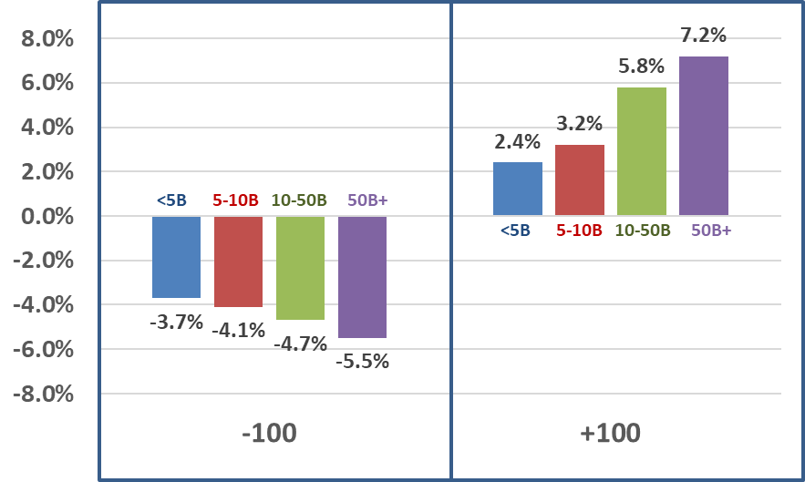
Public Bank Q12022 IRR Positioning
Public Bank interest rate risk positioning was still quite asset sensitive as of 2022Q1
Below are Average Net Interest Income Percentage Change in a -100 and +100 Immediate Rate Shock for various asset sizes
Page 10
Source: Stifel, S&P Global Market Intelligence, company reports
Represents immediate shocks
135 Banks, Averages

Slide 11
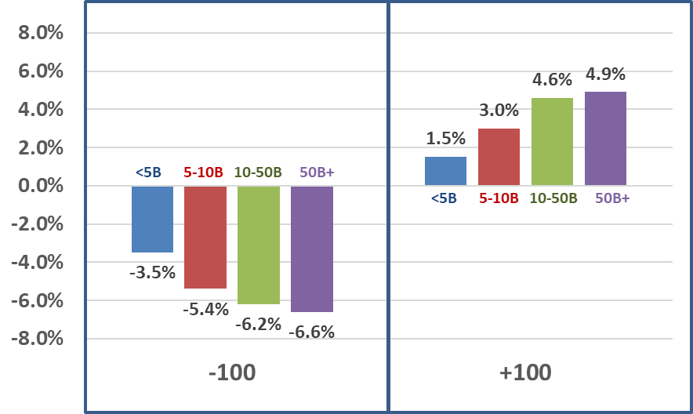
Public Bank Q22022 IRR Positioning
While public banks were still asset sensitive in 2022Q2, compared to 2022Q1, there is more down-rate risk
Below are Average Net Interest Income Percentage Change in a -100 and +100 Immediate Rate Shock for various asset sizes
Page 11
Source: Stifel, S&P Global Market Intelligence, company reports
Represents immediate shocks
135 Banks, Averages

Slide 12
2
2. Liquidity and Interest Rate Risk Positioning
Strategies and Considerations

Slide 13
Liquidity/IRR Consideration Matrix
Asset Sensitive
Large floating rate asset base
Lower cash balance
Strong loan demand
Large floating rate asset base
Higher cash balance
Limited loan demand
IRR Position
Low
Liquidity
Liquidity
Liquidity
Strong Liquidity
Large fixed rate asset base
Lower cash balance
Strong loan demand
Large fixed rate asset base
Higher cash balance
Limited loan demand
IRR Position
Liability Sensitive

Slide 14
Liquidity/IRR Consideration Matrix
Asset Sensitive
Large floating rate asset base
Higher cash balance
Limited loan demand
Consider:
Rates down protection through on-balance sheet strategies (cash deployment, duration extension in investment portfolio)
IRR Position
Liquidity
Strong Liquidity

Slide 15
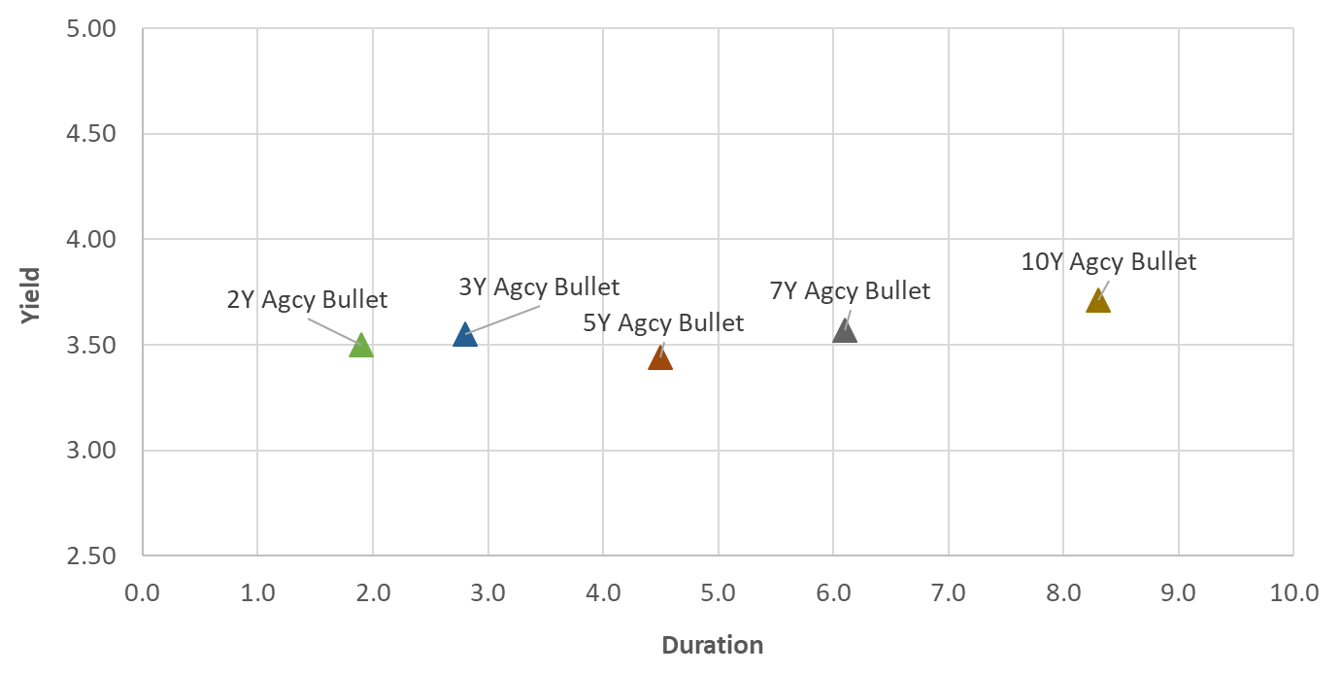
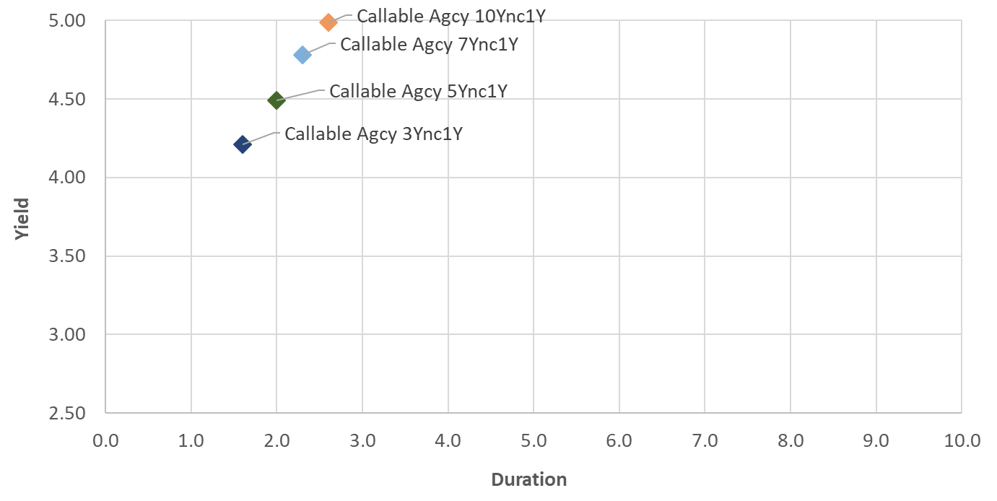
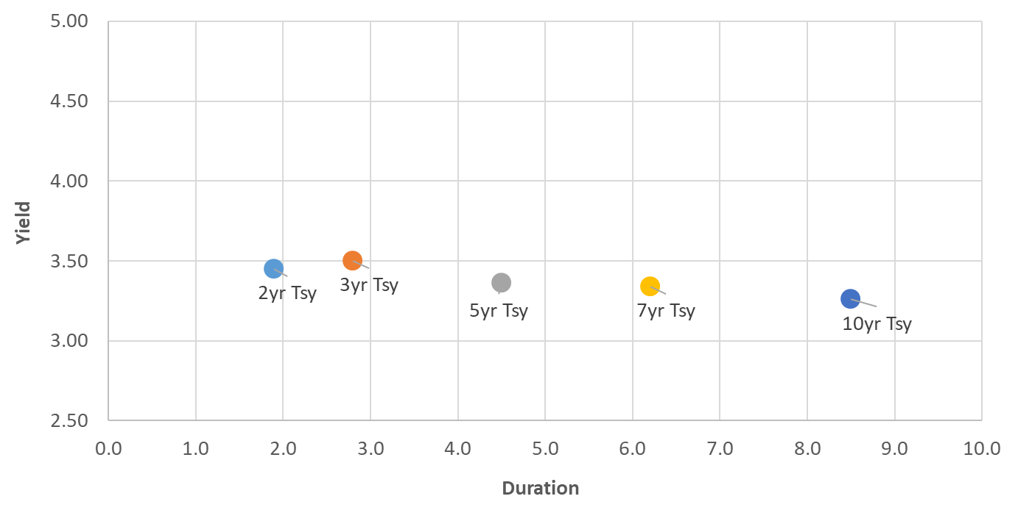
Fixed Income Landscape: Relative Value in Agency Debentures
The scatter-plot below shows the yield and duration for products within the fixed income landscape including treasuries, bullet agencies and callable agencies:
Pricing provided by Stifel Fixed Income Trading Desk as of 9/8/2022 and may not represent executable levels
Analytics provided by ZM and The Yield Book

Slide 16
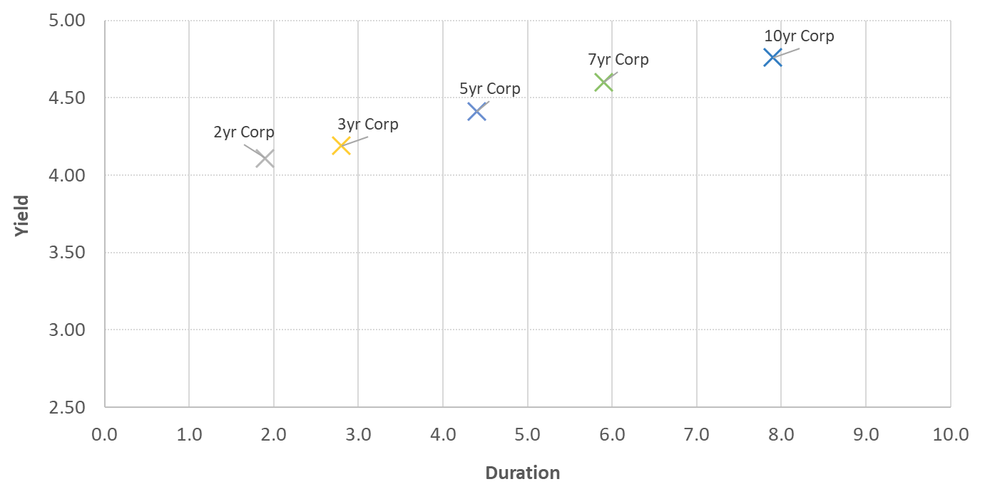
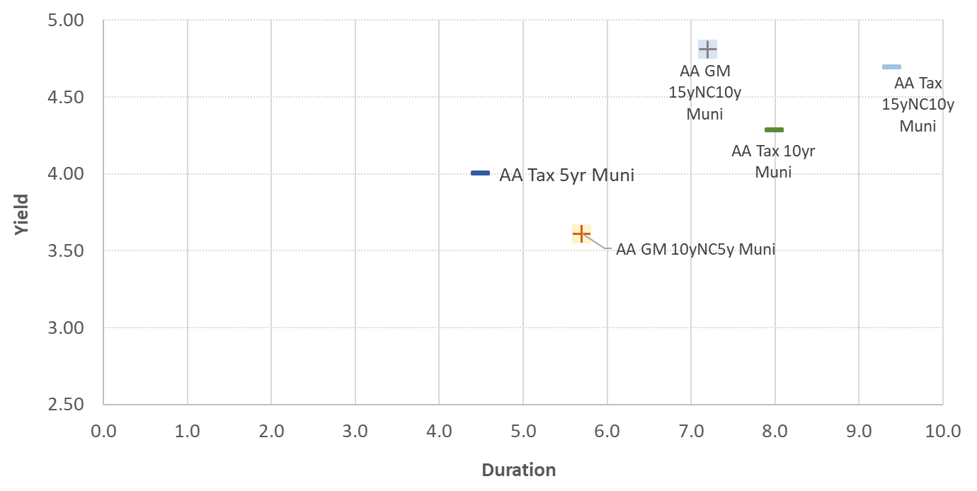
Fixed Income Landscape: Relative Value in Credit
The scatter-plot below shows the yield and duration for products within the fixed income landscape that have a credit component, including A Corporates (financials), AA General Market Municipals, and AA Taxable Municipals, with treasuries included for context:
Pricing provided by Stifel Fixed Income Trading Desk as of 9/8/2022 and may not represent executable levels
Analytics provided by ZM and The Yield Book

Slide 17
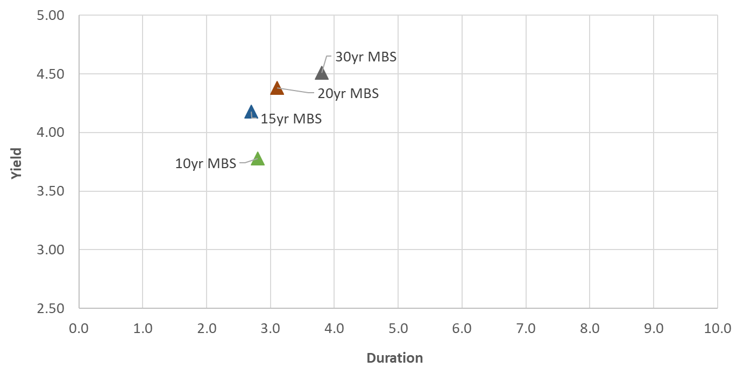
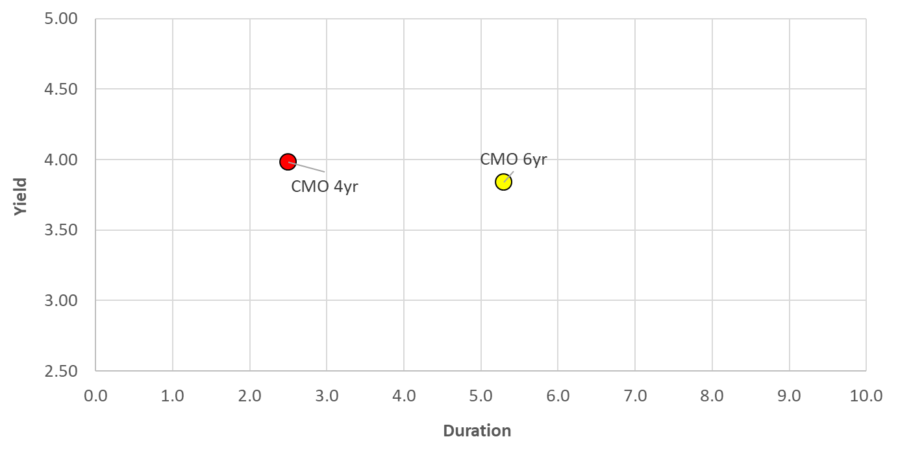
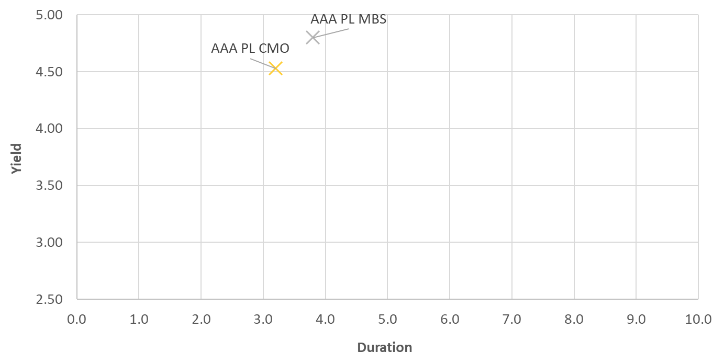
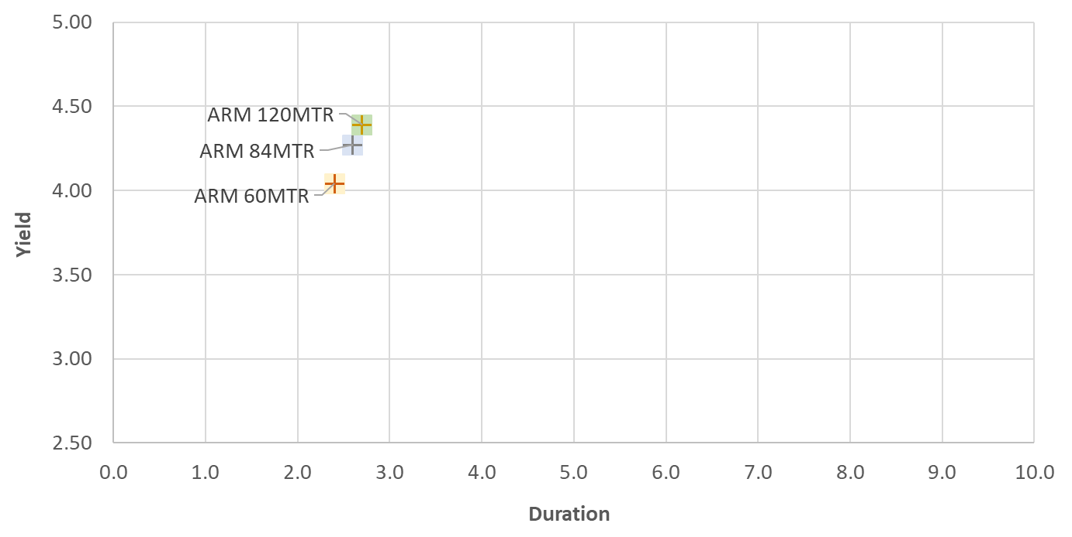
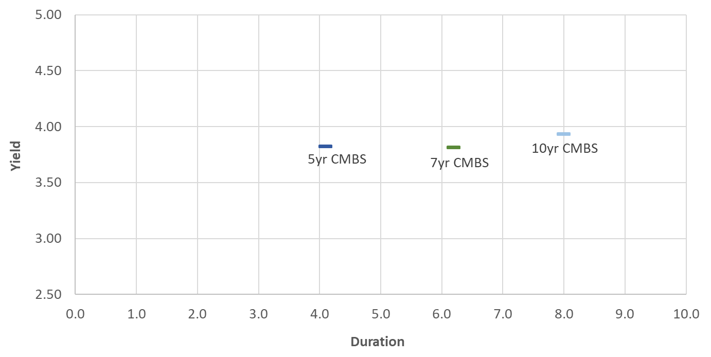
Fixed Income Landscape: Relative Value in Amortizing Product
The scatter-plot below shows the yield and duration for products within the fixed income landscape that are amortizing, including Fixed MBS, Agency CMOs, Private Label MBS & CMOs, Agency CMBS and Hybrid ARMs, and includes treasuries for context:
Pricing provided by Stifel Fixed Income Trading Desk as of 9/8/2022 and may not represent executable levels
Analytics provided by ZM and The Yield Book

Slide 18
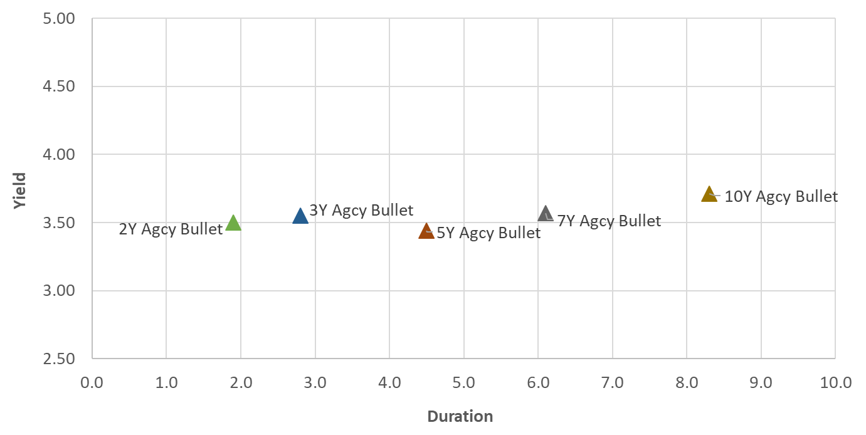
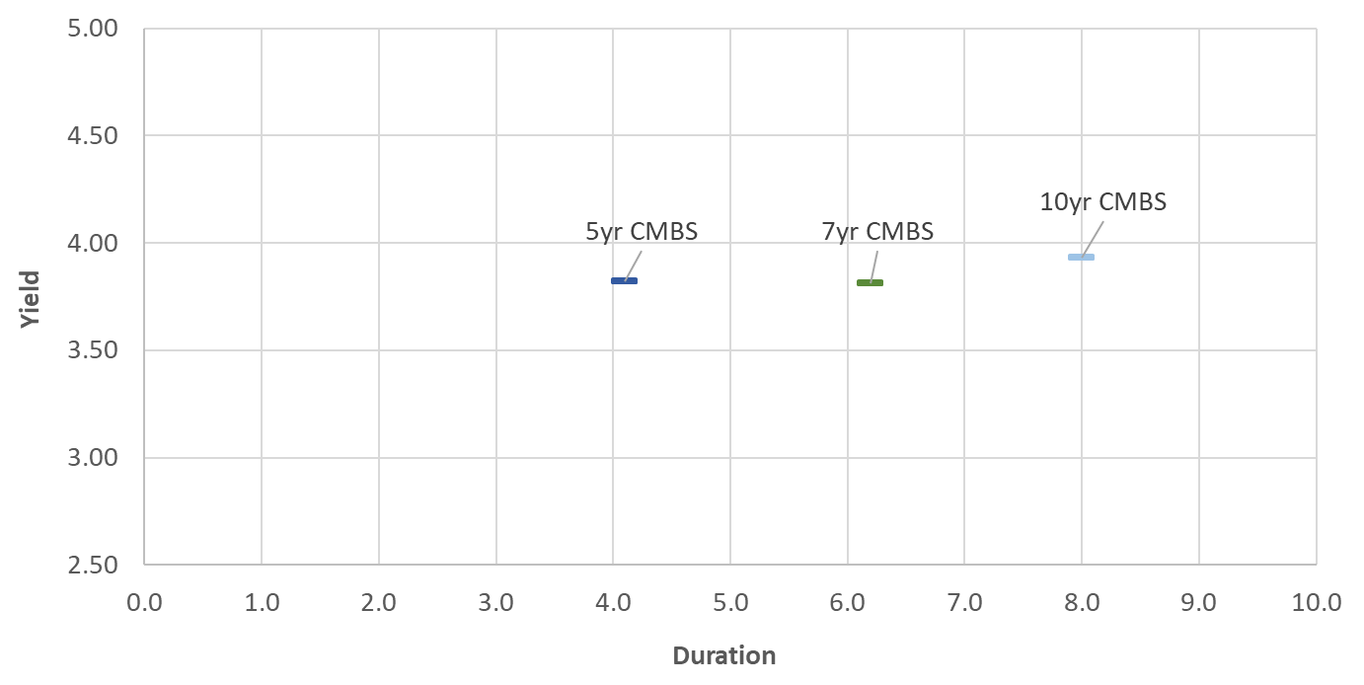
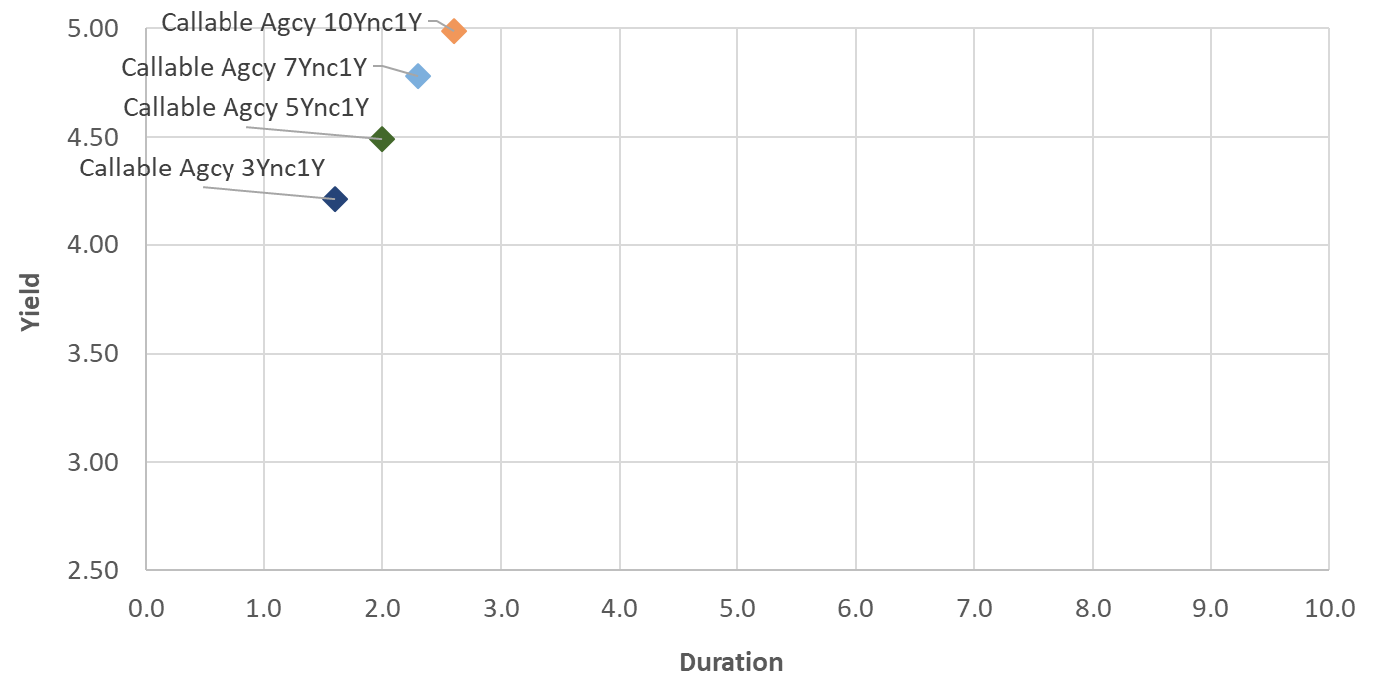
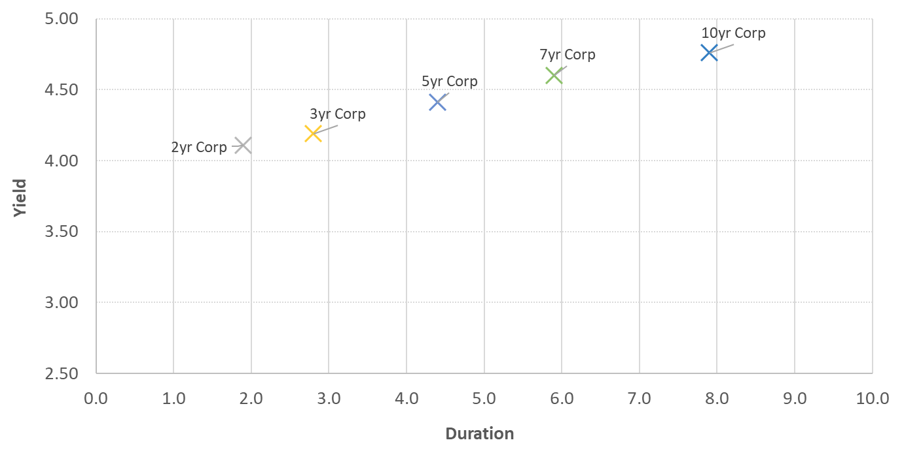
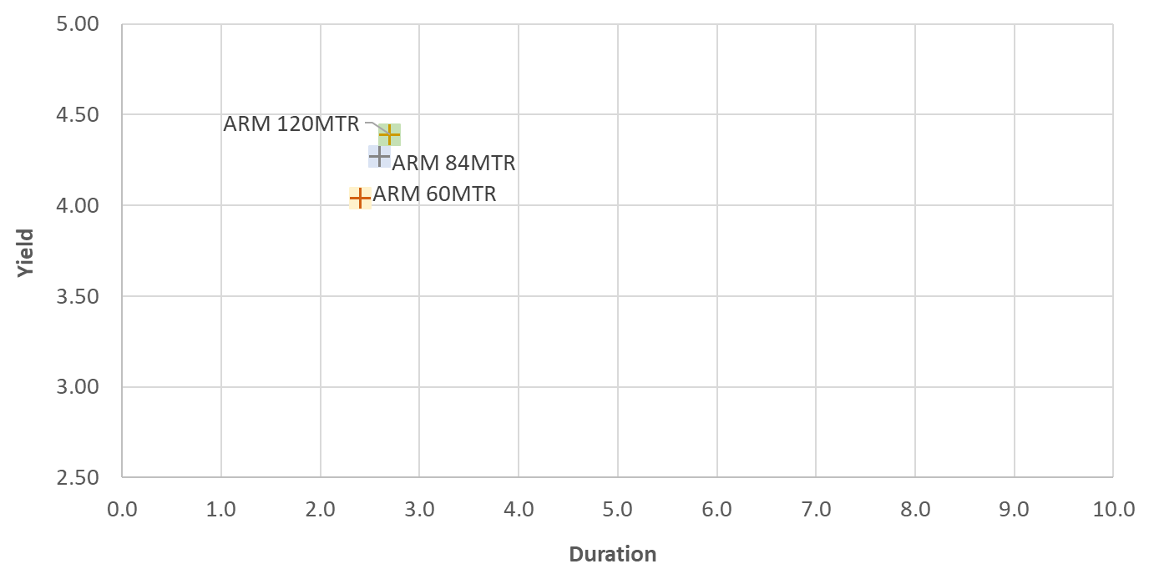
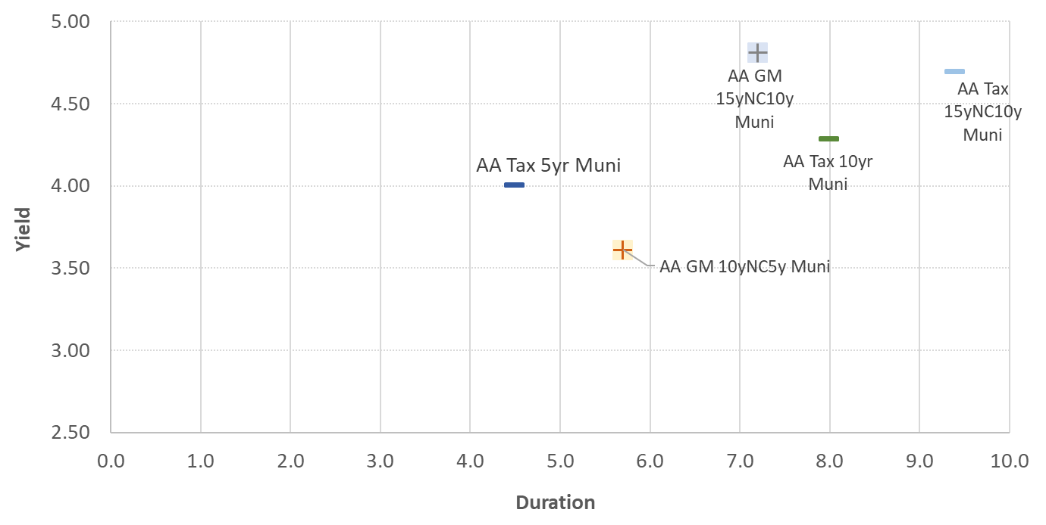
Fixed Income Landscape: All Fixed Rate Products – Relative Value
1) CMBS as “Bullet Surrogates”
2) Callables vs Amortizing Agcy Mtgs
The scatter-plot below shows all fixed rate products within the Fixed Income Landscape. In the 2-3yr duration space, callable agencies have strong relative value, while in the 7-10yr space, corporates and municipals have strong relative value
3) Private Labels as “Loan Surrogates”
4) Take on Duration in Corps & Munis
Pricing provided by Stifel Fixed Income Trading Desk as of 9/8/2022 and may not represent executable levels
Analytics provided by ZM and The Yield Book

Slide 19
Deploying Cash into Loans
For Banks that continue to hold cash on the balance sheet and have limited loan growth, loan purchases can be considered:
Page 19
Source: Stifel
Includes bank portfolios with >$100MM of Book Value who received portfolio analytics each month from Dec ‘21 – June ’22
Portfolio gain/loss includes all holdings, including those designated as HTM

Slide 20
Summary of Cash Deploy Strategies
Sample
The following analysis for Sample Bank shows the impacts of three $50mm cash deploy strategies with varying goals and constraints
Cash funds the purchase of a mix of Agency Debt, Agency MBS, Agency CMBS, Agency CMOs, Municipals and Corporates
Strategy 1: Short Allocation
$50mm cash deploy, +300 price volatility ~ 10.5%
Strategy 2: Mid Allocation
$50mm cash deploy, +300 price volatility ~ 13.5%
Strategy 3: Long Allocation
$50mm cash deploy, +300 price volatility ~ 15.5%
Pricing provided by Stifel Fixed Income Trading Desk as of 8/8/2022 and may not represent executable levels
Analytics provided by ZM and The Yield Book

Slide 21
Cash Deploy Allocations
Sample
Below are the allocations for the three strategies:
Pricing provided by Stifel Fixed Income Trading Desk as of 8/8/2022 and may not represent executable levels
Analytics provided by ZM and The Yield Book

Slide 22
Summary Comparison
Sample
Beginning portfolio data provided by Sample Bank as of 7/31/2022
Other beginning data provided by SNL as of 6/30/2022 LTM
Pricing provided by Stifel Fixed Income Trading Desk as of 8/8/2022 and may not represent executable levels
Analytics provided by ZM and The Yield Book

Slide 23
Liquidity/IRR Consideration Matrix
Asset Sensitive
Large floating rate asset base
Lower cash balance
Strong loan demand
Consider:
Rates down protection through hedging strategies
Leverage opportunities
IRR Position
Low
Liquidity
Liquidity

Slide 24
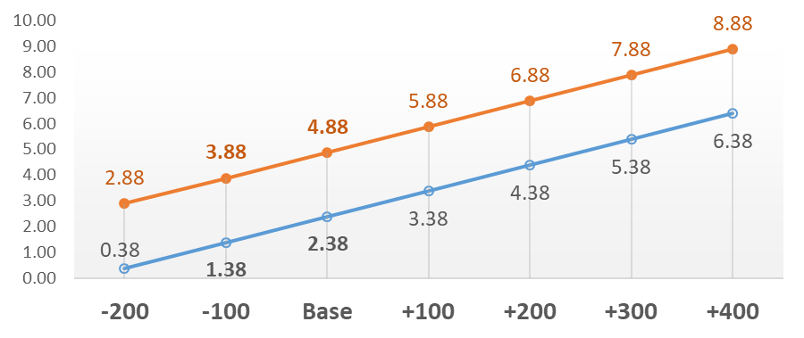
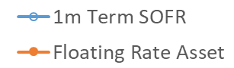
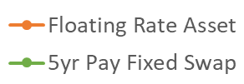
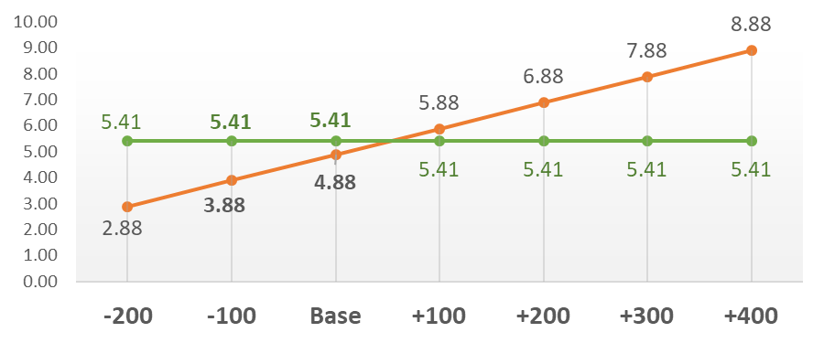
Rates Down Protection Strategies: Hedging Floating Rate Loan Book
For LIBOR/SOFR Floating Rate Loan Exposure, various hedging strategies can be used in order to protect for rates down
1m Term SOFR vs. Floating Asset Yield (SOFR+250bps)
  Asset sensitive banks will have floating rate loan pools that reprice higher as rates go up and reprice lower as rates go down
Floating Asset Yield (SOFR+250bps) vs. 5yr Receive Fixed Swap
  A receive fixed swap provides protection in rates down and positive carry in the base case, but gives up income appreciation in rates up
Indicative levels using 1 month term SOFR levels as of 8/24/22; may not represent executable levels.
Information presented above regarding interest rate derivatives is considered general and factual. Please see further disclosures on the last page of this presentation.

Slide 25
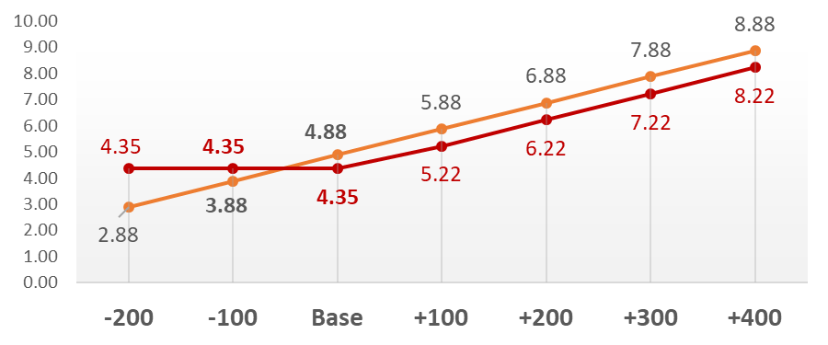
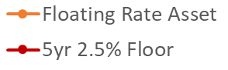
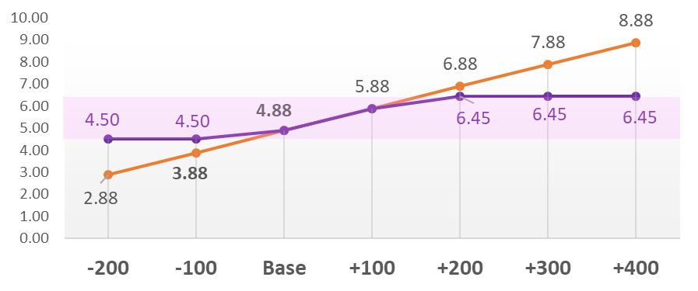
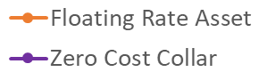
Rates Down Protection Strategies: Hedging Floating Rate Loan Book
For LIBOR/SOFR Floating Rate Loan Exposure, various hedging strategies can be used in order to protect for rates down
Floating Asset Yield (SOFR+250bps) vs. 5yr 2.5% Floor
  Buying a 5yr 2.5% floor costs 53bps in the base case, but pays for itself if rates go down 100bps
Floating Asset Yield (SOFR+250bps) vs. Zero Cost Collar
  A Zero Cost Collar sells a cap to pay for the cost of a floor
  With zero upfront premium, the strategy creates a band in which the asset floats
  The minimum payoff in this example is 4.50% (1mo CME Term SOFR Floor of 2.00%) and a maximum payoff of 6.45% (1mo CME Term SOFR Cap of 3.95%)
Indicative levels using 1 month term SOFR levels as of 8/24/22; may not represent executable levels.
Information presented above regarding interest rate derivatives is considered general and factual. Please see further disclosures on the last page of this presentation.

Slide 26
Short Wholesale Funding Menu/Optimization
Thoughts on Wholesale Funding Relative Value Across Channels and Tenors
Overnight to 1 month: FHLB (only available source)
3 month to 1 year: Brokered CD (bullet structure)
CD Pricing provided by Stifel Fixed Income Brokered CD Desk as of 8/29/2022 and may not represent executable levels
FHLB Pricing an average of publicly available rates as of 8/30/2022 and may not represent executable levels

Slide 27
Liquidity/IRR Consideration Matrix
Liquidity
Strong Liquidity
Large fixed rate asset base
Higher cash balance
Limited loan demand
Consider:
Cash deployment into short duration/hedged assets
IRR Position
Liability Sensitive

Slide 28
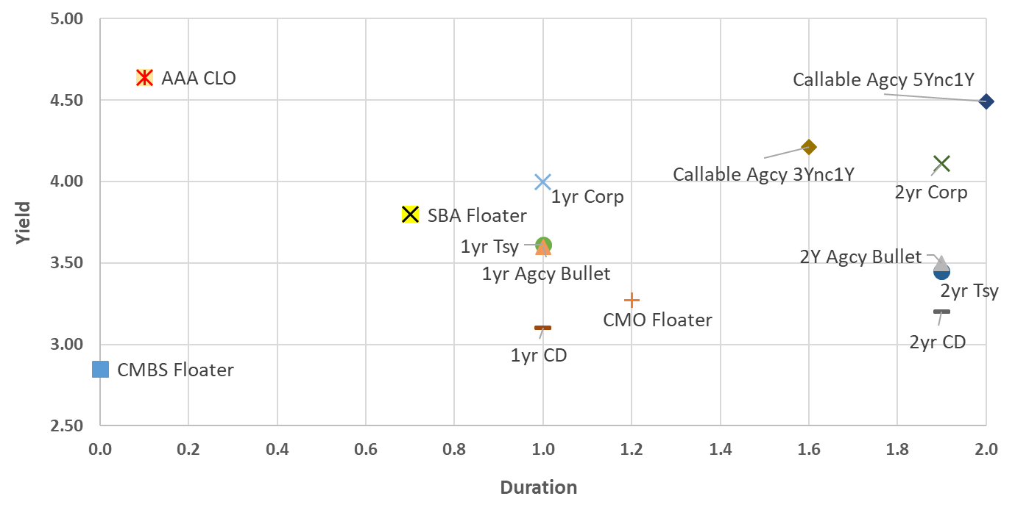
Fixed Income Landscape: Relative Value in Floating Rate & Short Fixed Rate Securities
The scatter-plot below shows products within the fixed income landscape that have less than 2yr Duration in a static rate environment, including Floating CMBS, Floating CMOs, Floating SBAs, CLOs, short treasuries, short CDs, short Corporates, short Bullet Agencies and short Callable Agencies
Pricing provided by Stifel Fixed Income Trading Desk as of 8/22/2022 and may not represent executable levels
Analytics provided by ZM and The Yield Book

Slide 29
Executive Overview: Creating Synthetic Floaters by Swapping Fixed to Float
Strategy Overview
Partial term fair value hedging allows a financial institution to create floating-rate or fixed-to-floating rate exposures by pairing an underlying fixed rate security with an interest rate swap. This strategy captures the spread, without the full benchmark interest rate risk, associated with longer duration securities.
Discount Margins
On the longer end of the curve, certain Agency CMBS and municipal securities can offer compelling back-end discount margins, given the spreads that are offered
Examples:
  AA Taxable Municipal 11yrNC9yr immediately swapped to +107 basis points over SOFR (up to call date)
Hedged positions where the underlying bond has a discount dollar price reflect a hedge notional equal to the book value, while hedged positions where the underlying bond has a premium dollar price reflects a hedge notional equal to current face
Indicative levels as of 8/26/22; may not represent executable levels.
Taxable equivalent yields represent zero cost of funds and 21% marginal federal tax rate.
Interest rate swap maturities match the first call date of the security.
Price shocks represent an immediate parallel curve shock.
Hedged position yields are uncapped/unfloored
Hedged position yields and discount margins reflect a weighted average based on book value of the asset and the notional amount of the interest rate swap
Information presented above regarding interest rate derivatives is considered general and factual. Please see further disclosures on the last page of this presentation.

Slide 30
Liquidity/IRR Consideration Matrix
Low
Liquidity
Liquidity
Large fixed rate asset base
Lower cash balance
Strong loan demand
Consider:
Hedged funding strategies
IRR Position
Liability Sensitive

Slide 31
Swapping Floating Borrowings to Fixed
The grid to the right shows indicative levels for effective funding cost of rolling FHLB Des Moines funding and swapping to fixed
Effective funding cost equals fixed swap rate plus estimated funding spread between FHLB and SOFR across various funding structures (3 month fixed rollover)
5Y Example Below
Fixed Swap Rate
3.02 %
Spot Starting
(swap enters accrual period immediately)
Funding Source
Floating Rate
3.15%
Bank
Swap Counterparty
Floating Rate
2.91%
Funding
Swap
Indicative levels using SOFR swap levels as of 8/26/22; may not represent executable levels.
Des Moines FHLB Rates as of 8/26/2022
Information presented above regarding interest rate derivatives is considered general and factual. Please see further disclosures on the last page of this presentation.

Slide 32
3
3. Take Loss-Earn Back Strategies

Slide 33
Liquidity/IRR Consideration Matrix
Asset Sensitive
Large floating rate asset base
Lower cash balance
Strong loan demand
Large floating rate asset base
Higher cash balance
Limited loan demand
IRR Position
Loss-Earnback Strategy
Low
Liquidity
Liquidity
Liquidity
Strong Liquidity
Large fixed rate asset base
Low cash
Strong loan demand
Large fixed rate asset base
Higher liquidity
Limited loan demand
IRR Position
Liability Sensitive

Slide 34
Tying it All Together: Portfolio Restructuring through Take Loss-Earn Back Strategy
Why is this a good time to do a portfolio restructure?
  Majority of portfolios consist of fixed rate securities with relatively low yields.
  Portfolios are a much larger part of the overall balance sheet; restructure without adding.
  Allows for opportunity to take advantage of relatively high yields across various points on the curve.
  This rate cycle is moving quickly; this could be the window to restructure, while the economics work.
Take Loss-Earn Back Strategy
The current environment allows for the removal of low yielding securities at a one-time loss, and reinvestment into higher yielding bonds to increase go forward earnings and valuations
Boosts Implied Valuations
Financial institutions valued based on tangible book and forward earnings – the trade improves both over a time horizon.
Maximizing Portfolio Returns
Despite the historical preference for avoiding losses, maximizing portfolio returns during a rising rate environment often requires taking losses.
Liquidity
Agnostic
Regardless of the liquidity situation, this trade allows for investing into this higher yield curve without using liquidity or growing the portfolio.
Interest Rate Risk Management
The trade can serve as an opportunity to alter and manage interest rate risk by becoming more or less asset sensitive via the reinvestment choice.
Better Earnings Shield Losses
Many institutions are ahead of budget due to rapid increase in Fed Funds beyond initial projections – improved earnings helps to shield losses elsewhere.

Slide 35
How are One-time Losses Perceived? What About Earn Back Periods?
One-time Losses: How are they perceived by investors and analysts?
Typically, one-time losses (and gains) on securities are considered “non-core” and are excluded from profitability calculations.
Generally, securities gains and losses are eliminated from operating income, as they are often one-time in nature, and are reflected in equity previously.⁽¹⁾
Earn Back Periods: In what framework should this be measured?
While M&A transactions and securities portfolio restructurings are very different in nature, the concept of the earn back period remains relevant.
  M&A Transactions: A buyer is said to “earn back” the dilution they create in their tangible book value per share (“TBVPS”) which inevitably gets diluted when issuing shares and/or paying cash for a target.
  Securities Restructurings: The earn back period refers to the time it takes for the income generated to eclipse the one-time loss.
  The Big Difference: While M&A Deals dilute TBVPS and accrete Earnings per share (EPS) over time, the securities take loss-earn back trade does not dilute TBVPS (already in equity), and begins to improve EPS in the immediate period in which the loss is taken.
(1) KBW’s Bankbook: A Comprehensive View of the Banking Industry, July 2021; Chris McGratty, CFA, Chris O’Connell, CFA, Andrew Leischner

Slide 36
Loss-Earn Back Sell Candidates: AA Municipal Curve Steepness
Optimal break-even sale candidates will vary by institution, but generally include bullet and bullet-like securities that have rolled down the curve over the last four years. This includes corporates, ACMBS, and municipals.
Municipal securities in particular make ideal sell candidates, as the tax-exempt curve retains significant steepness on both an absolute and relative basis.
Although absolute municipal levels are significantly higher than they were in 2022, the municipal curve looks similar to how it looked in 2018, but even steeper on the front-end. As a result, intermediate tax-exempt positions purchased several years ago have very small losses or even marginal gains.
Municipal and Treasury Yield Curves – 2022 and 2018
Shorter municipal securities that have rolled down that take advantage of the positive municipal slope make very good loss break-even sell candidates.
2s/10s Spreads – Municipal vs. Treasuries
In terms of relative steepness, the gap between 2s/10s spreads in tax-exempts and treasury space has not been this wide since 2018, when many institutions programmatically sold short munis.
Page 36
Sources: Bloomberg, Stifel

Slide 37
Loss-Earn Back Reinvestment Candidates: Extension Opportunity
The shape and steepness of curve also favors longer municipals as a reinvestment. This break-even/extension strategy essentially sells short ‘retail’ municipal structures and buys longer institutional structures.
Long-end muni-treasury ratios peaked over 110% in April and now hover around 100%, which looks very attractive vs. ratios that averaged 75.8% through all of calendar 2021.
Much of the cheapness on the long-end is attributable to forced selling out of municipal funds, not fundamental credit concerns.
Municipal Mutual Fund Flows vs. Muni/Treasury Ratios
Periods of sustained or dramatic municipal fund inflows (outflows) tend to result in meaningful spread compression (widening).
Muni-to-Treasury Ratios have hit almost 100%, the highest since Fall 2020, following sustained outflows averaging -$3.3bn weekly since January 1st.
Page 37
Sources: Bloomberg, Stifel, iShares

Slide 38

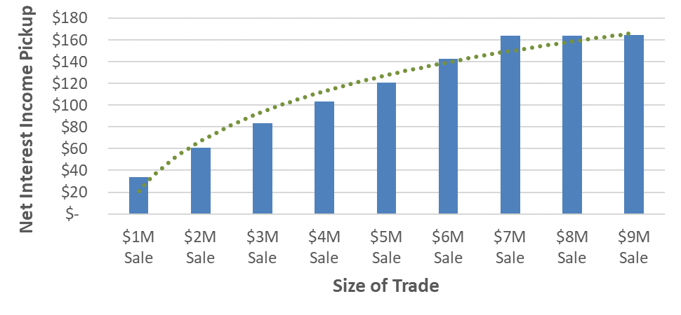
Loss Earn Back Methodology: Optimizing based on Goals and Constraints
Methodology: When solving for the optimal mix of securities to sell in a loss earn back transaction, it is essential to create a framework of goals and constraints.
Goal is to improve go forward earnings subject to the following constraints:
  Constraint 1: Earn back Period
  Constraint 2: Loss amount
  Constraint 3: Transaction Size
  Constraint 4: Sector Sale Limitations
  Constraint 5: Specific Reinvestment
Case Study: Goal is to improve go-forward earnings with the most efficient sale size that generates the most earnings, subject to a 1yr earn back period and reinvestment in longer municipals:
Case Study: Most Efficient Sale Size with 1yr Earn Back
$7M Sale size generates the most income, levels off beyond that

Slide 39
Case Study: Sample Loss Earn Back Strategy (1 Year Earn Back, $7M Sale)
Sample Bank: $500M Total Assets, Asset Sensitive, 8.0% Loss in Current AFS Portfolio
What are we selling and buying?
Selling Short: Security sales have a weighted average book yield of 2.32%, a WAL of 2.6yrs and a duration of 2.4, comprised of mostly CMBS, Municipals and Corporates that have rolled down the curve.
Buying Long: Municipal purchases have a weighted average book yield of 4.70%, a WAL of 10.0yrs and a duration of 9.4.

Slide 40
Case Study: Sample Loss Earn Back Strategy (1 Year Earn Back, $7M Sale)
Sample Bank: $500M Total Assets, Asset Sensitive, 8.0% Loss in Current AFS Portfolio
How do we derive a 1yr Earn Back?
Earn Back Math: The ($129k) one-time loss is offset by +$129k income pickup, resulting in a 1 year earn back.
Go-Forward Earnings: The strategy generates 238bps of positive spread.

Slide 41
Case Study: Sample Loss Earn Back Strategy (1 Year Earn Back, $7M Sale)
What is the Portfolio Impact?
Current Portfolio: $200M portfolio with weighted average book yield of 2.30%, 6yr WAL, 5.0 Duration, and -5.1% +100 Px. Vol.
Pro Forma Portfolio Impacts : Selling less than 5% of the overall portfolio, a one-time pre-tax loss of $163k results in an 8bp increase to book yield, a 0.3 increase to duration, and makes the Bank less asset sensitive (i.e., provides more down-rate protection)

Slide 42
Case Study: Sample Loss Earn Back Strategy (1 Year Earn Back, $7M Sale)
What are Earnings & Capital Impacts?
Capital Impacts
Reduces Tier 1 Leverage due to one-time loss
Improves CET1 Ratio and TRBC Ratio due to sale of 100% RW Corporates and reinvestment into 20% RW Municipals
TCE/TA Ratio at time zero is unchanged, as the loss content is already embedded in tangible common equity
Earnings Impacts
Annual ROAA improves by 3bps
Annual ROAE improves by 32bps
Net Interest Margin increases by 5bps, as $163k is added to Net Interest Income

Slide 43
Considerations
While requests for portfolio restructure modeling will often be centered around the bond portfolio, there are situations where gains from elsewhere on the balance sheet allow for portfolio clean-up opportunities:
Loan Sales: Gains from selling out of the loan portfolio can be one way to offset losses in the securities portfolio.
Visa B Shares: In preparation for its IPO in 2008, Visa issued Class B shares to its member banks as a way to eliminate the potential impact of a negative result in the Interchange Action. The shares are owned exclusively by U.S. financial institutions and their affiliates and successors. Most Visa B shares are held at a $0 value, making all proceeds booked as one-time gains. These gains can be paired with losses in the bond or loan portfolio to increase profitability.
Reserves: In the final stretch up to the credit standard’s final effective date for non PBE’s on January 1, 2023, certain institutions are re-evaluating their current reserves in 3Q and 4Q ‘22. These actions could lead to income events that could be utilized to offset losses where appropriate.
One-off Gains: In the course of doing business, there are times in which gains that hadn’t been budgeted can become available within any given quarter. Examples include but are not limited to the sale of a building or other real estate owned, a branch sale, or gains from a joint venture. These unpredictable occurrences are valuable opportunities to offset losses in a portfolio restructuring.

Slide 44
4
4. Managing Tangible Book Value (TBV) and Tangible Common Equity (TCE)

Slide 45
AOCI Impact as a Percent of Prior Period TCE
The combination of larger securities balances, rapid curve movement, and lower HTM utilization resulted in record (or near record) TBV/TCE declines during the quarter 1Q2022. The median AOCI decline as a percent of TCE was -6.2% (with an average of -8.2%). This compares to medians closer to -2% in prior periods.
Despite this decline, KBW notes that equity performance for public traded institutions has still been positive and largely decoupled from AOCI performance. Investors remain focused on the stronger earnings power of most institutions in the current rate environment.
Median AOCI Change as a Percent of Prior Period Tangible Common Equity
“Despite the more significant marks than expected, KBW’s conclusion is that AOCI has been just one factor driving stock performance, and not the primary factor….the most significant negative stock outliers were largely a combination of multiple factors, including AOCI marks, weak deposit growth, and lack of forward guidance increases. However, for the 24 banks that reported at least 10% negative impacts to tangible book value, less than half of these banks underperformed, and the most significant underperformers were all primarily driven by other idiosyncratic factors/events.”
        -KBW AOCI Tracker: What Banks Have Reported & What's Still to Come, April 24, 2022
Page 45
Source: S&P Global Intelligence

Slide 46
HTM Utilization and Tangible Book Value at Risk
The table below analyzes TBV at risk and TCE/TA across rate scenarios for a group of 19 peers that Stifel ran portfolios for as of 6/30/2022 with $2.5Bn to $5.0Bn in total assets:
Gain/(Loss) % is entire portfolio and does not take AFS vs HTM into account
Includes 19 Banks for which Stifel has a run a securities portfolio as of 6/30/2022, with total assets between $2.5Bn and $5.0Bn
Total Assets, TCE and TBV data per S&P Global as of 3/31/2022
Notes:
Remove bank 3, change column 3 title to fit assets on one cell

Slide 47
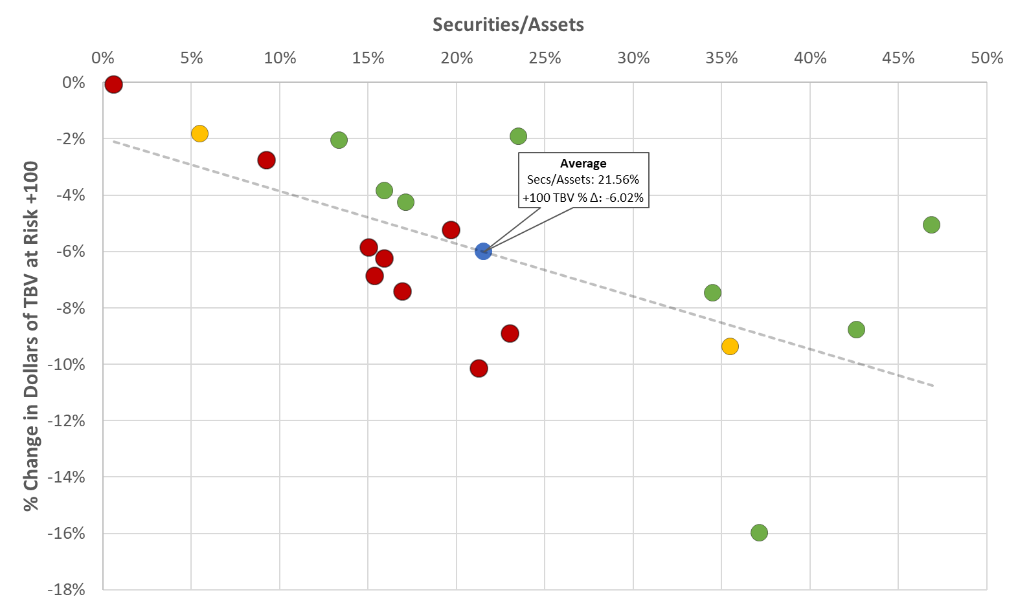
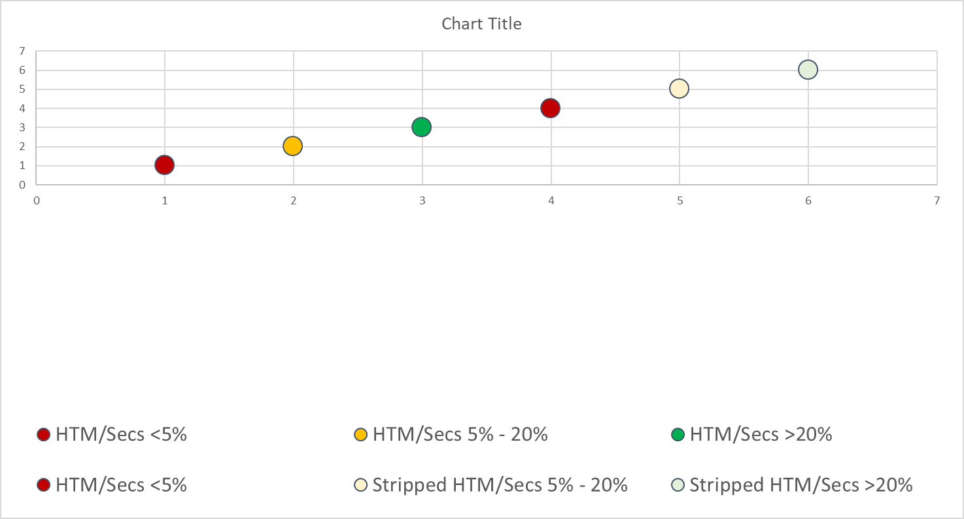
TBV at Risk for $2.5Bn-5.0Bn Peer Group
The following graph explores the relationship between size of portfolio, TBV at risk, and HTM utilization. The chart analyzes 19 peers that Stifel ran a portfolio for as of 6/30/2022 with Total Assets between $2.5Bn and $5.0Bn.
Includes 19 Banks for which Stifel has a run a securities portfolio as of 6/30/2022, with total assets between $2.5Bn and $5.0Bn
Total Assets, TCE and TBV data per S&P Global as of 3/31/2022

