Slide 1
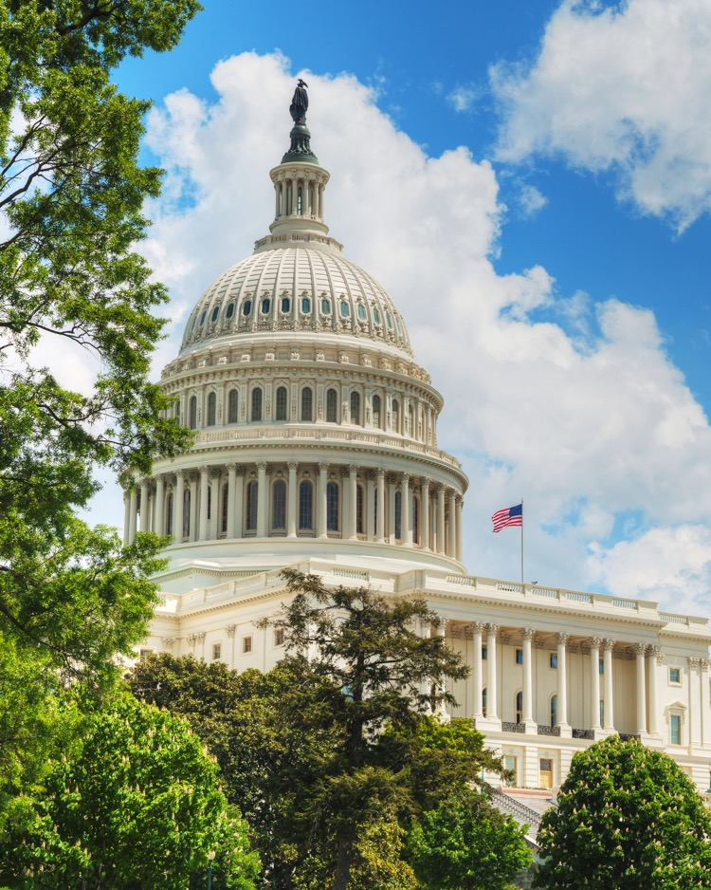
SERVING YOUR COMMUNITY BANK THROUGH Advocacy. Education. Innovation.
Dedicated to our mission for more than 90 years: To create and promote an environment where community banks flourish

Slide 2
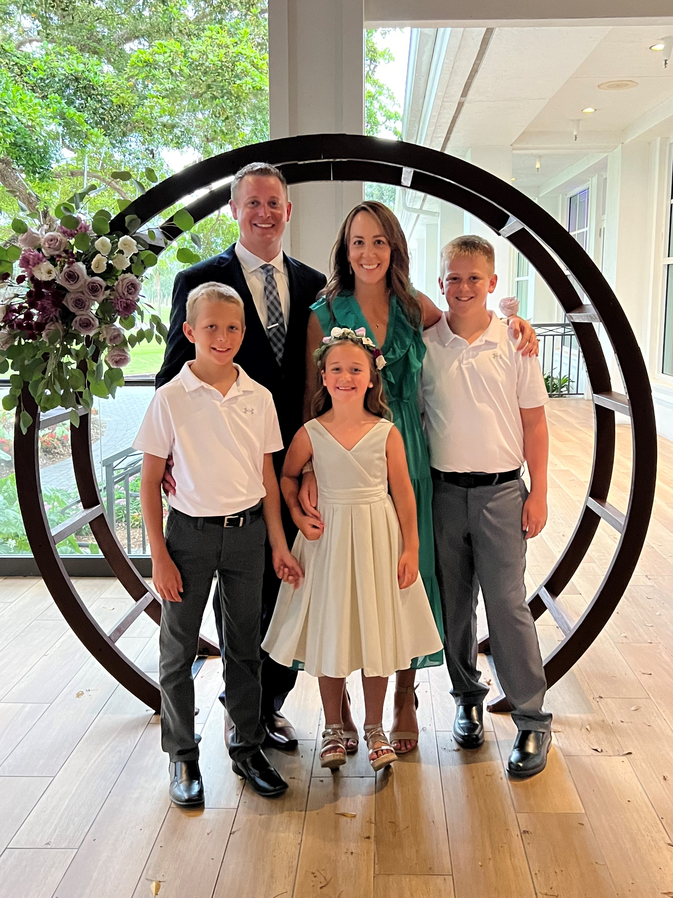
Sarah Getzlaff
Security First Bank of North Dakota
Notes:
Insert an image of yourself and your bank or yourself with a customer.

Slide 3
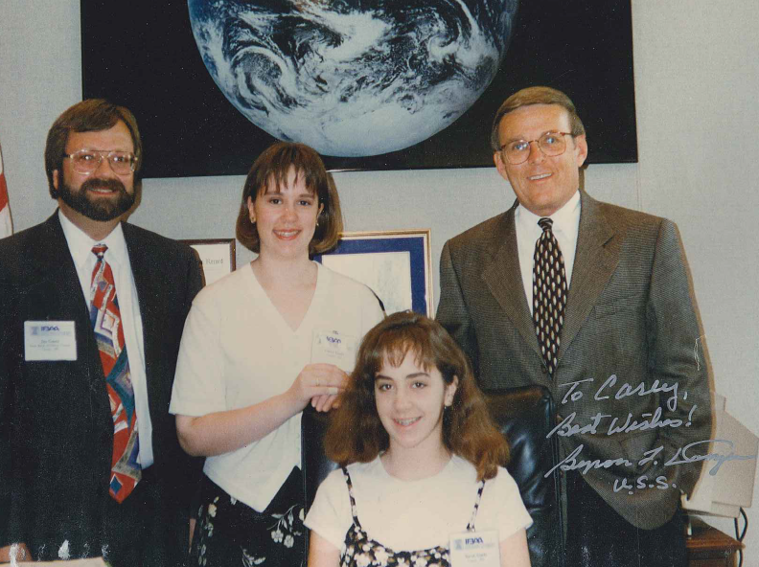
1996 ICBA Capital Summit: A Teenage Dream
Notes:
Insert an image of yourself and your bank or yourself with a customer.

Slide 4
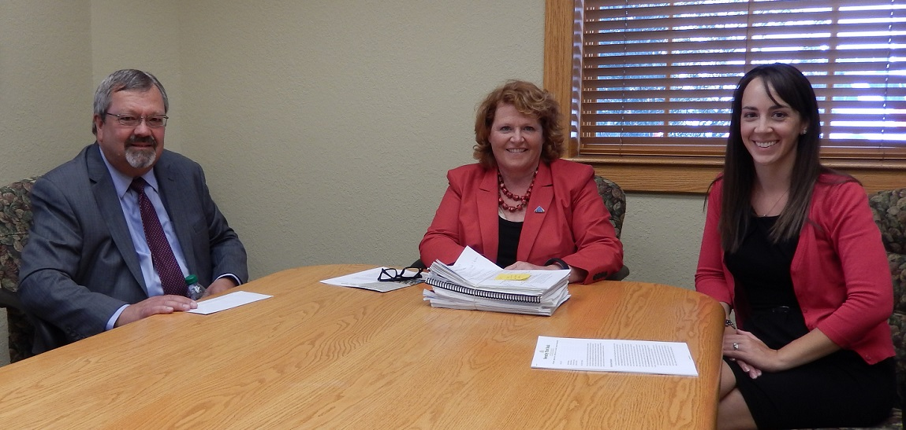
Regulatory Compliance: The Making of an Advocate
Notes:
Insert an image of yourself and your bank or yourself with a customer.

Slide 5
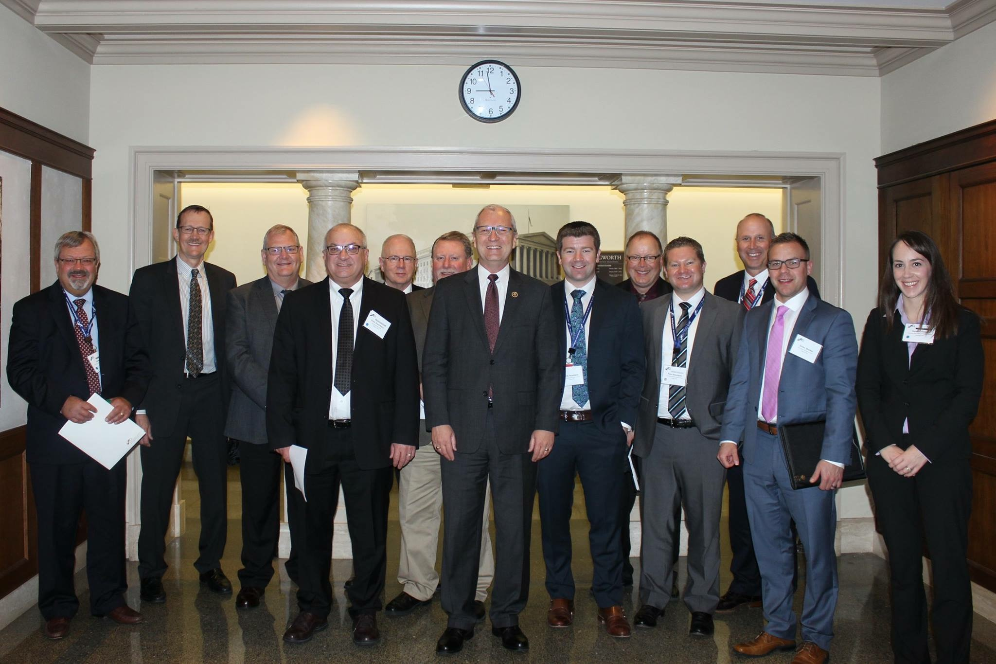
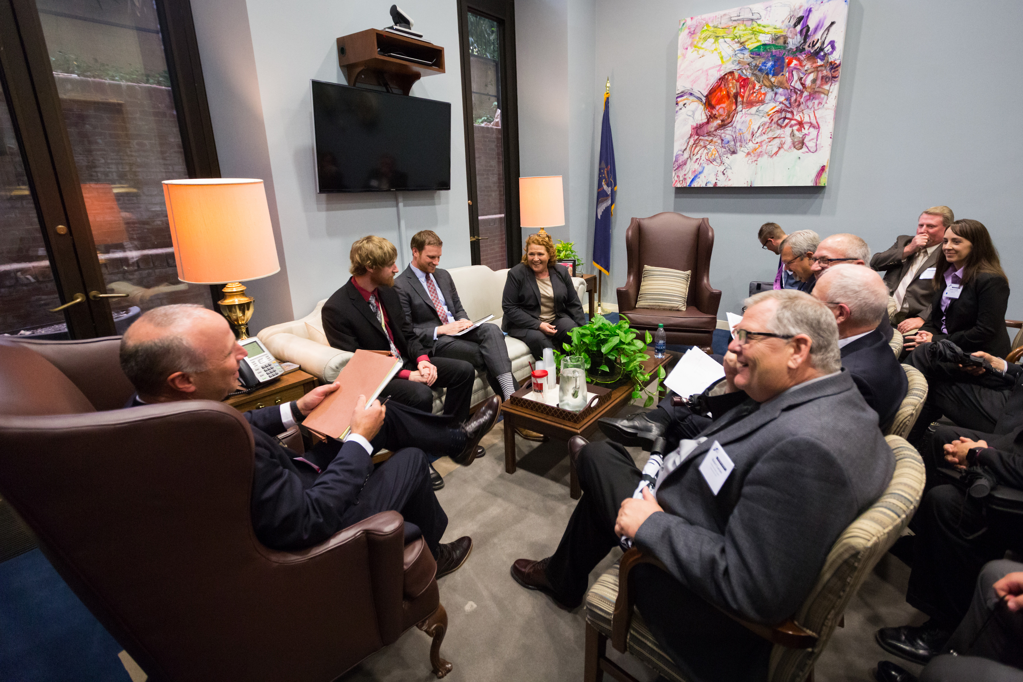
2016 Capital Summit: Standing Up and Speaking Out
Notes:
Insert an image of yourself and your bank or yourself with a customer.

Slide 6
Targeted Advocacy.
Tangible Results.
ICBA exclusively promotes the community bank agenda before Congress, the administration and regulators—ensuring your voice is heard loud and clear.

Slide 7
IRS Privacy Campaign
#KeepMyBankingPrivate
Comprehensive, multichannel effort to engage and activate ICBA members and their bank customers through market research and grassroots actions.
Generated more than 700,000 messages and thousands of phone calls to Congress. Experienced 3,000 percent increase in web traffic to BankLocally.org
Association Trends Silver TRENDY Award
icba.org/privacy and banklocally.org/privacy
ADVOCACY UPDATE

Slide 8
Advocacy That Helps Your Community Bank Flourish
Not all banks are the same. Community banks deserve targeted community bank-focused advocacy. Examples include:
Position on climate change regulation
Action on closing the ILC loophole
Leadership on the SAFE Banking Act
Public opposition to Omarova’s OCC Nomination
Identification and successful fight against the harmful bank IRS provision
Garnering additional PPP funding for community banks
Winning community banks Fannie Mae and Freddie Mac Preferred Stock and 5-year NOL carryback
Gaining community bank access and representation in FedNow
Installing a Federal Reserve board member with community banking experience
The list goes on…

Slide 9
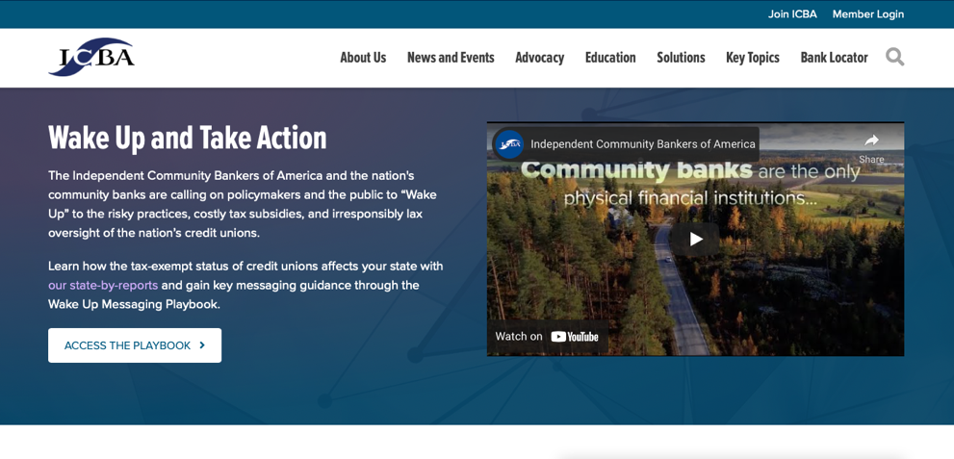
ICBA Launched the "Wake Up" Campaign and Credit Union Task Force
ICBA’s "Wake Up" campaign and Credit Union Task Force leverage research to identify messaging and strategies to help drive action and results on this critical community banking issue.
ADVOCACY UPDATE
ADVOCACY UPDATE

Slide 10
Dodd-Frank Act Section 1071
ICBA continues to strongly support a robust community bank exemption from Dodd-Frank Act Section 1071.
The CFPB’s proposed rule is too narrow and would apply to far too many community banks.
The CFPB should reconsider the impact of this proposed rule on small-business lending and access to credit before proceeding with a final rule.
ADVOCACY UPDATE
ADVOCACY UPDATE

Slide 11
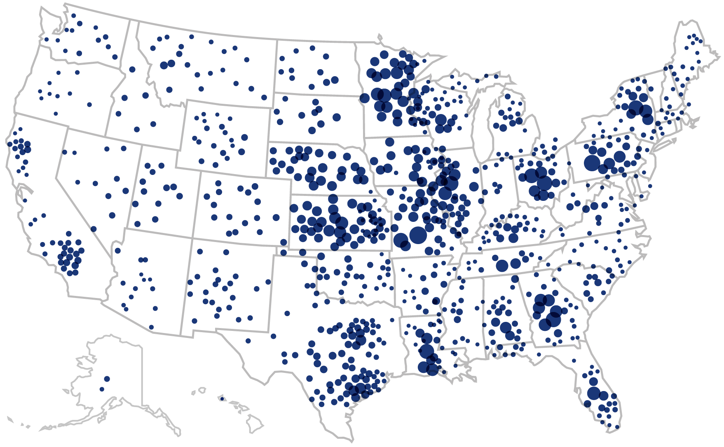
Community Banks
Comprise 99% of all banks and have 50,000+ locations nationwide
Provide over 60% of all small business loans
Made 60% of all PPP loans.
Make over 80% of agricultural loans
Employ nearly 750,000 people
Are the only physical banking presence in one-third of U.S. counties

Slide 12
Dedication to Innovation. Demonstrated Results.
ICBA has led the way in establishing innovative partnerships and solutions that will help your bank grow and thrive in the years ahead.

Slide 13
ICBA ThinkTECH Accelerator
INNOVATION UPDATE
ICBA has taken big strides in the field of innovation with our ICBA ThinkTECH Accelerator program.
icba.org/thinktech

Slide 14
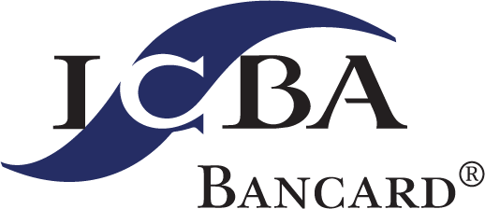
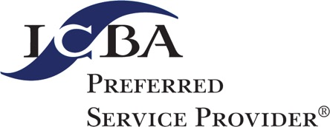
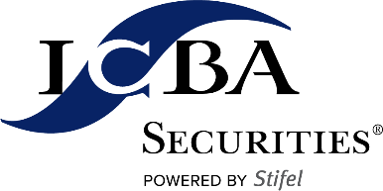
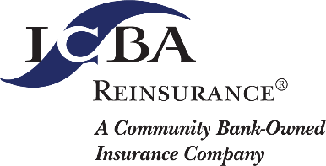
ICBA Services & Preferred Service Providers
INNOVATION UPDATE
icba.org/solutions

Slide 15
Regulatory Compliance: The Making of an Advocate
Notes:
Insert an image of yourself and your bank or yourself with a customer.

Slide 16
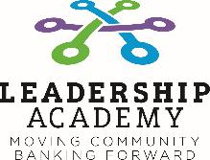
How We Do It
Professional Certifications
Practical Education: In Your Style. At Your Pace.
EDUCATION UPDATE
Auditing
Bank Security
BSA/AML
Commercial Lending
Compliance
Consumer Lending
Credit Analyst
Information Technology
Risk Management
LIVE EVENTS: 35+ events delivered in-person and virtual livestream
WEBINARS: 70+ interactive webinars and 144+ recorded webinars MP3/MP4 downloads
Comprehensive Programs
ONLINE TRAINING: 350+ online courses and online administration. Plus 7 online certificate programs.
RESOURCES: 100+ diverse educational publications and digital tools.
The Compliance Vault is included with ICBA membership.
icba.org/education

Slide 17
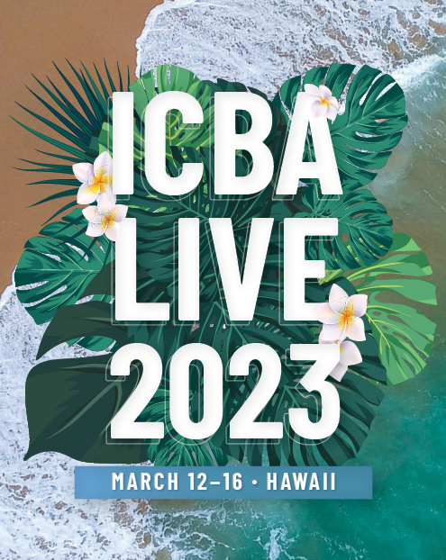
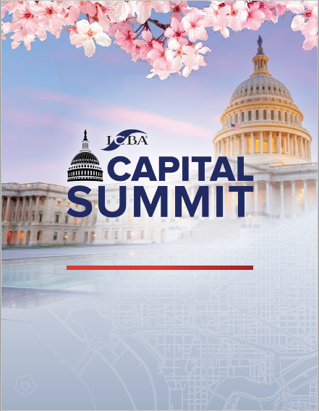
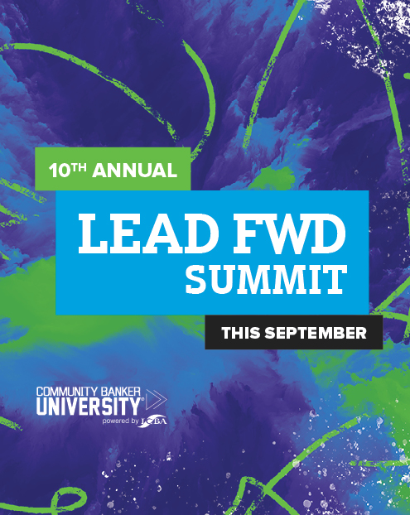
Keep Learning!
EDUCATION UPDATE
Sept. 12-13, 2022 • Fort Worth, Texas
icba.org/education

Slide 19
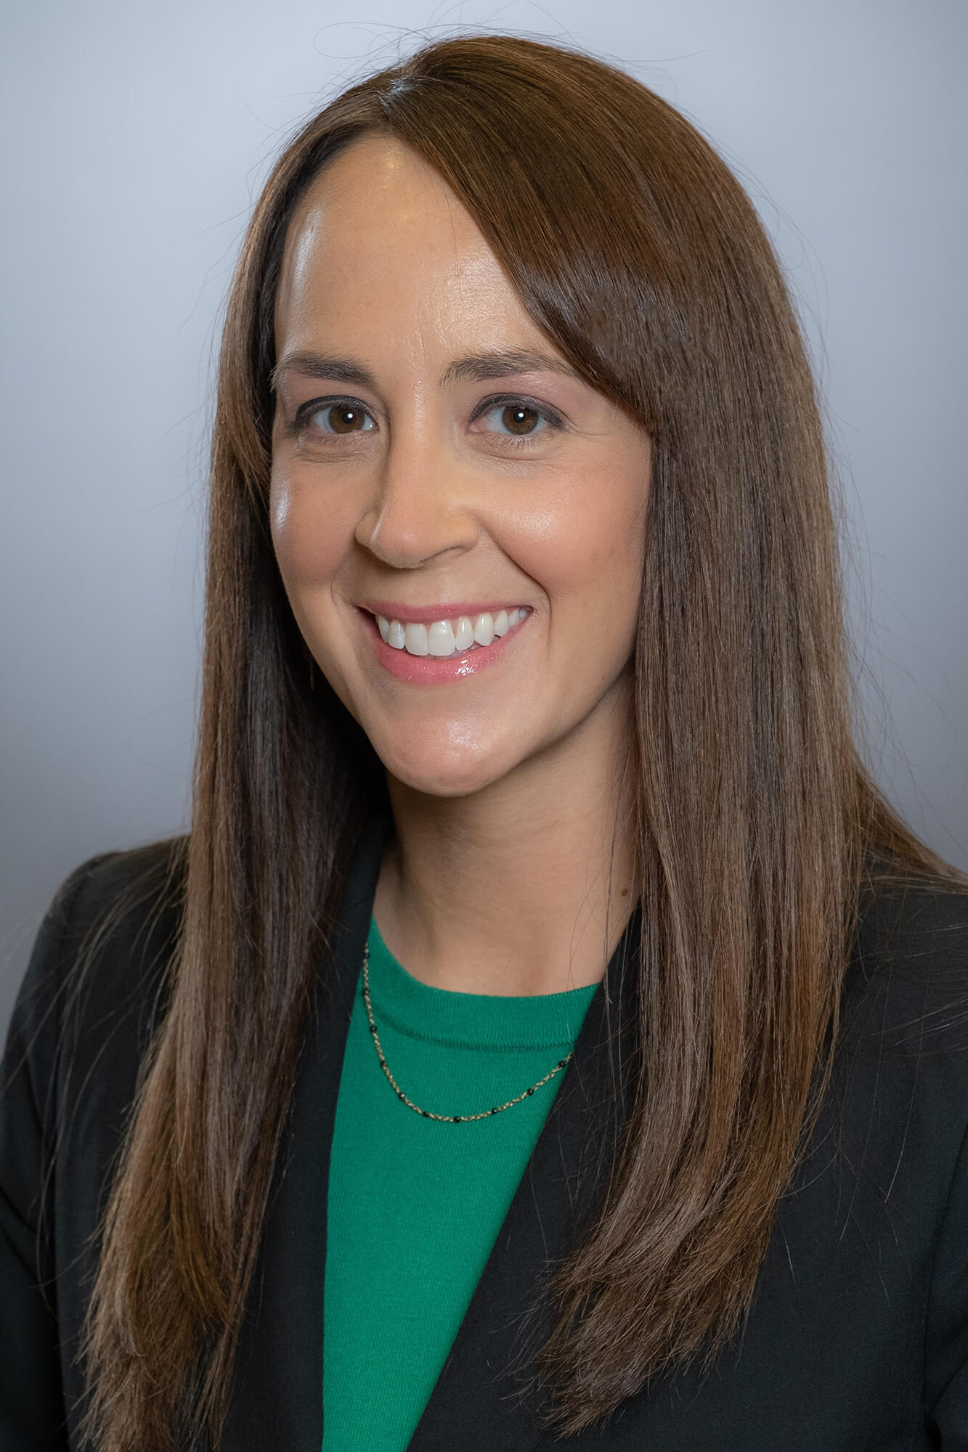
Thank you Sarah Getzlaff CEO, Security First Bank of North Dakota, Bismarck, N.D. 701-222-4444 Sarah@SecurityFirstBank.bank @SarahGetzlaff
Your continued partnership and dedication to ICBA and community banking makes positive change possible.
Notes:
Be sure to update this slide with your name and information.

